Slide 1
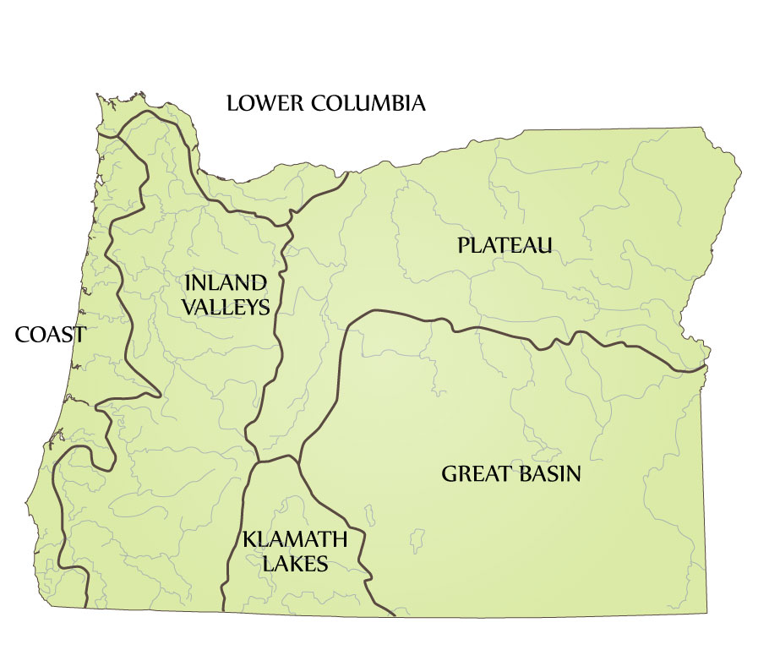
Natural & Cultural Areas of Traditional Oregon
Notes:
Source: Zucker, J., Hummel, K., Høgfoss, B., Hosey, F., & Penniman, J. (1983). Oregon Indians: Culture, history, & current affairs, an atlas & introduction. Portland, OR: Western Imprints, the Press of the Oregon Historical Society.

Slide 2
Lower Columbia

Slide 3
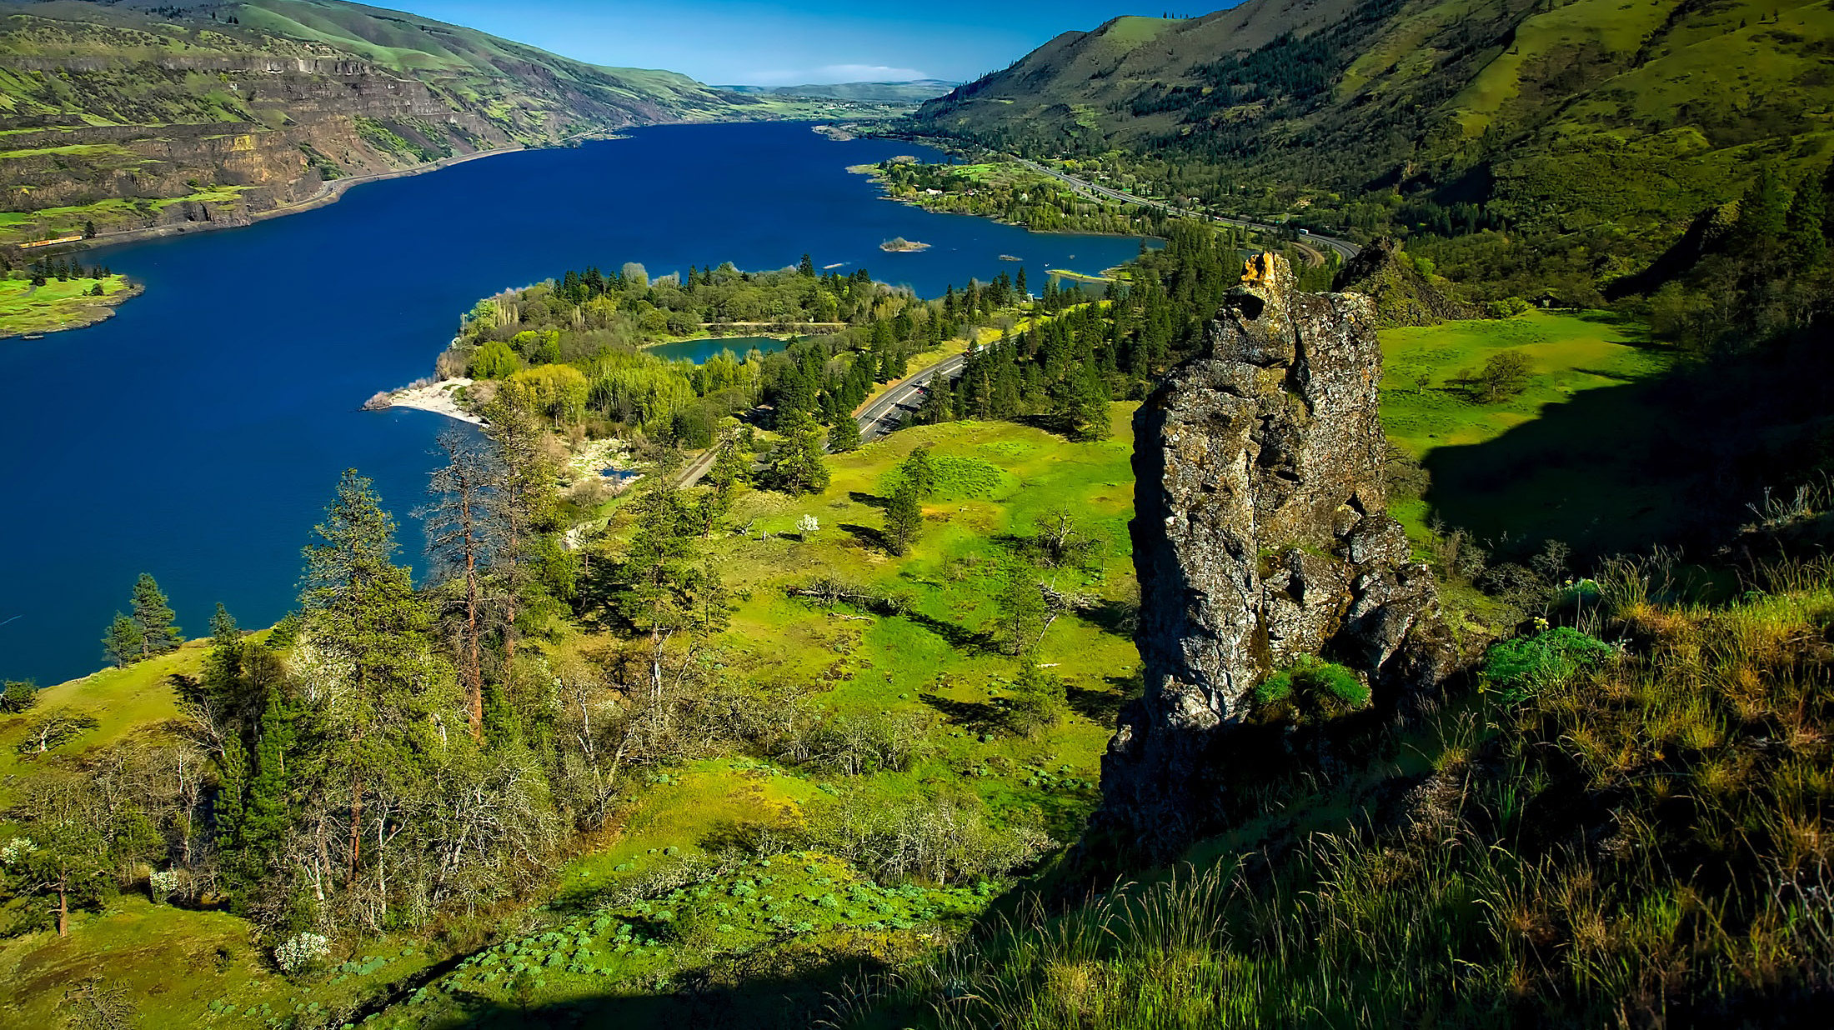
Lower Columbia
Notes:
Columbia River Valley landscape in Oregon

Slide 4
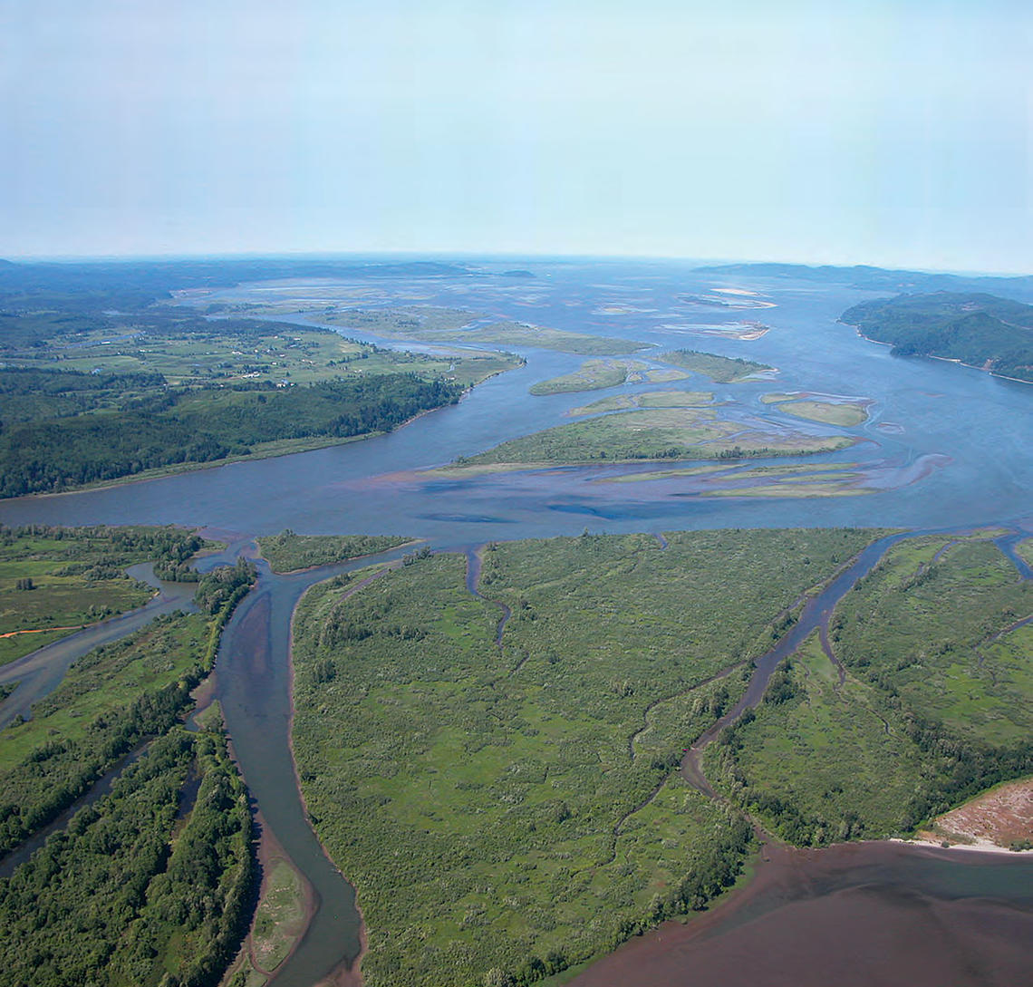
Lower Columbia
Notes:
Lower Columbia River estuary

Slide 5
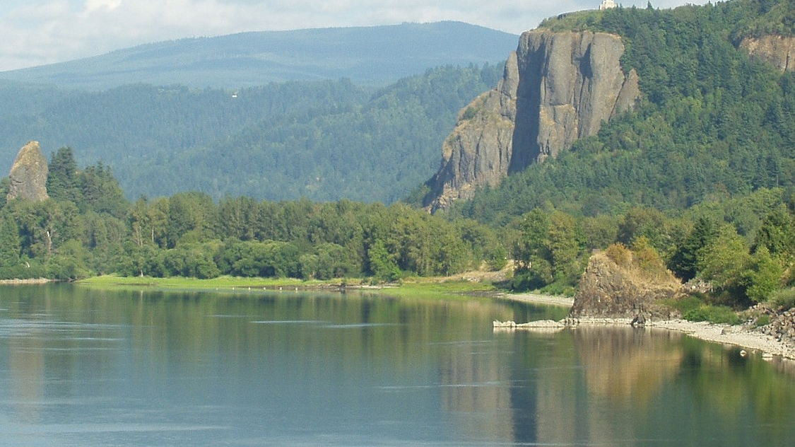
Lower Columbia
Notes:
Columbia River Gorge

Slide 6
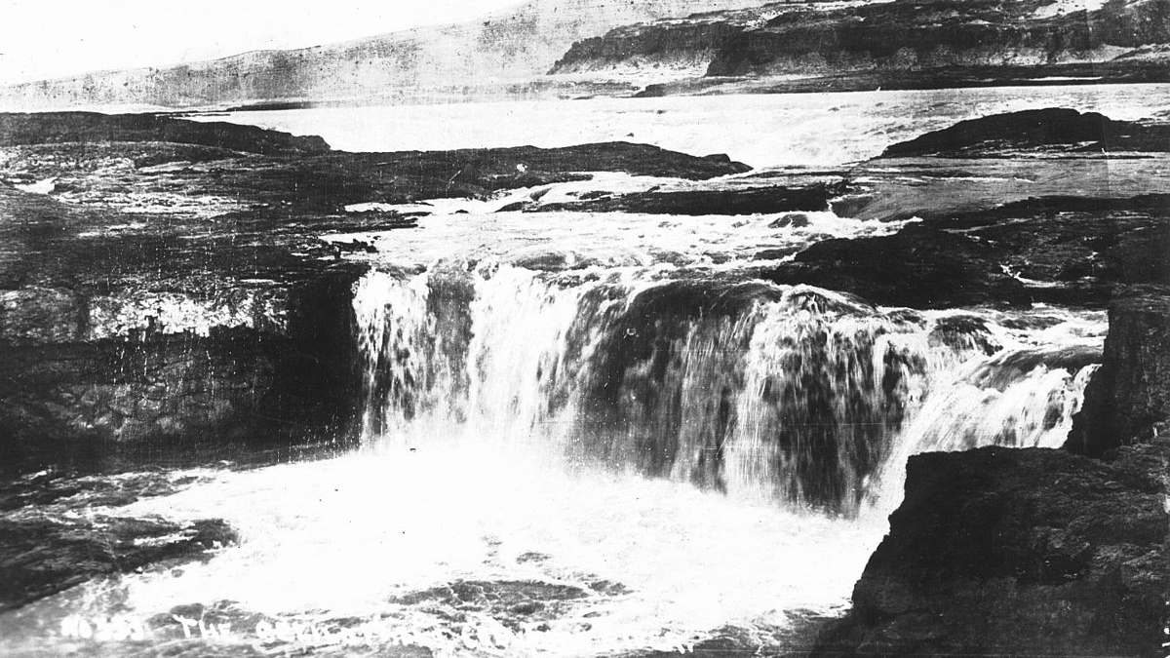
Lower Columbia
Notes:
Celilo Falls (The falls no longer exists because the Dalles Dam backed up the river and covered it.)

Slide 7
Lower Columbia
What do you notice?
What do you wonder?

Slide 8
Coast

Slide 9
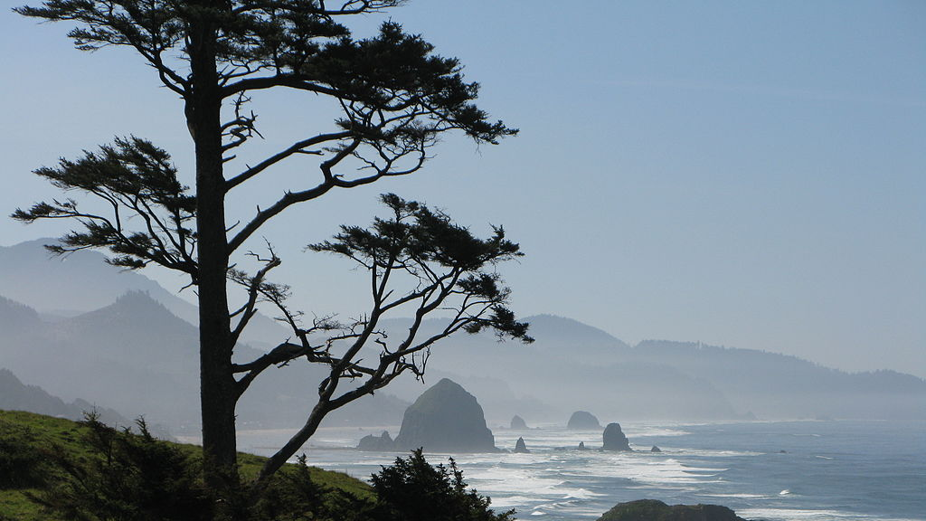
Coast
Notes:
Oregon coast, Ecola State Park, Haystack Rock

Slide 10
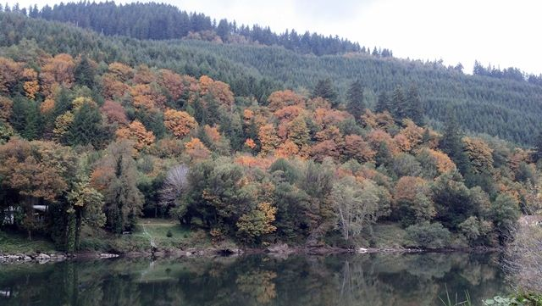
Coast
Notes:
Coos Bay, Oregon

Slide 11
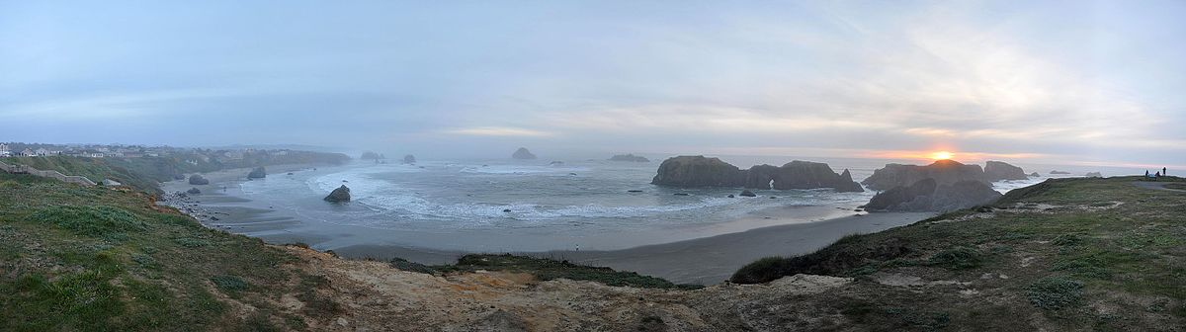
Coast
Notes:
Sunset panorama from Coquille Point in Bandon, Oregon. Oregon Islands National Wildlife Refuge.

Slide 12
Coast
What do you notice?
What do you wonder?

Slide 13
Inland Valleys

Slide 14
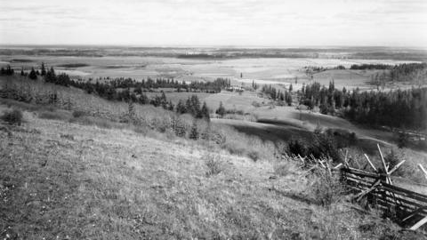
Inland Valleys
Notes:
Willamette Valley near Woodburn (1909-1914)

Slide 15
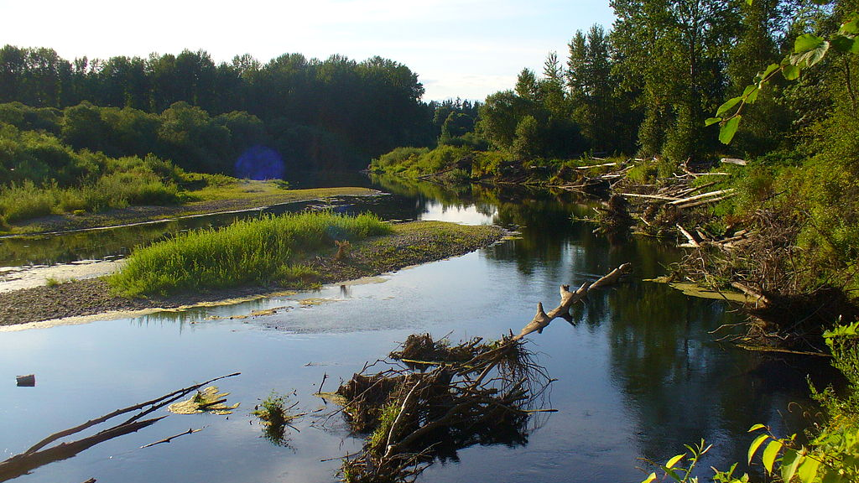
Inland Valleys
Notes:
View of the Molalla River

Slide 16
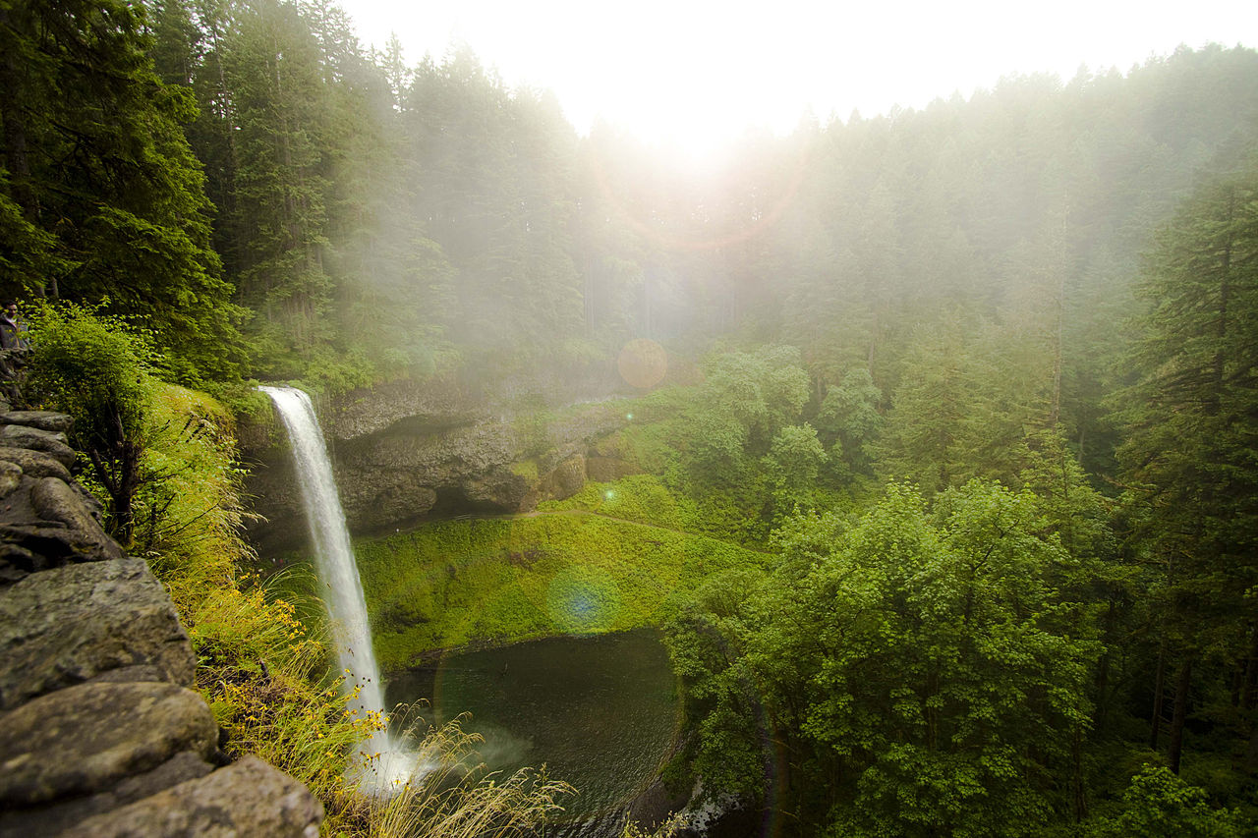
Inland Valleys
Notes:
Waterfalls of Silver Falls State Park

Slide 17
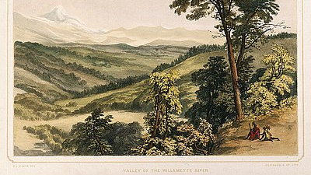
Inland Valleys
Notes:
Historic postcard drawings of the Willamette Valley

Slide 18
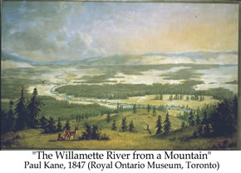
Inland Valleys
Notes:
Historic postcard drawings of the Willamette Valley

Slide 19
Inland Valleys
What do you notice?
What do you wonder?

Slide 20
Klamath Lakes

Slide 21
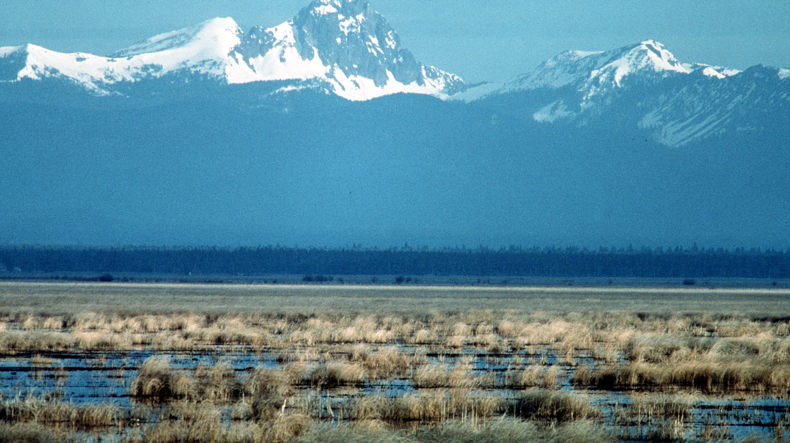
Klamath Lakes Area
Notes:
Klamath County Marshes

Slide 22
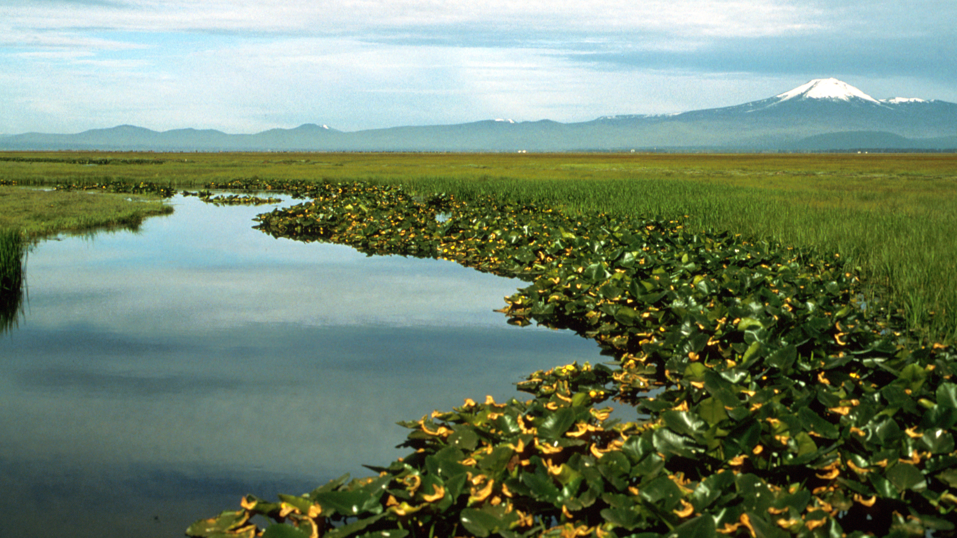
Klamath Lakes Area
Notes:
Lower Klamath National Wildlife Refuge in Oregon

Slide 23
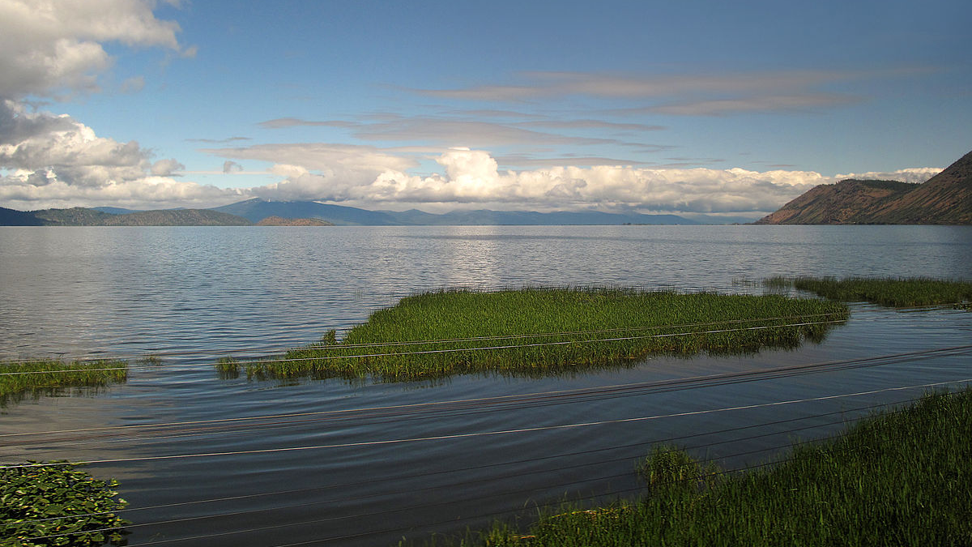
Klamath Lakes Area
Notes:
Upper Klamath Lake

Slide 24
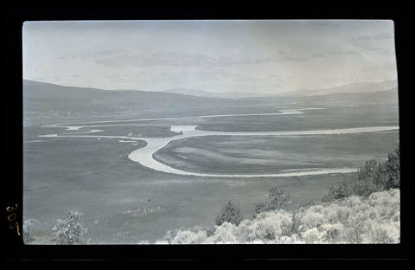
Klamath Lakes Area
Notes:
Klamath River (1912)

Slide 25
Klamath Lakes Area
What do you notice?
What do you wonder?

Slide 26
Plateau

Slide 27
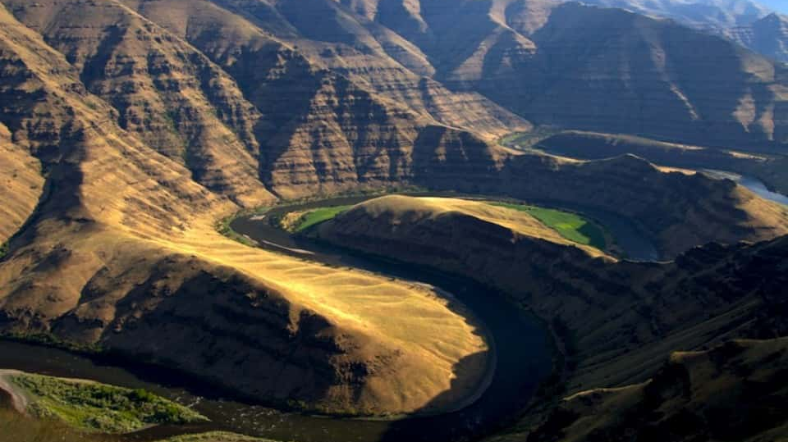
Plateau
Notes:
Grande Ronde Rivers

Slide 28
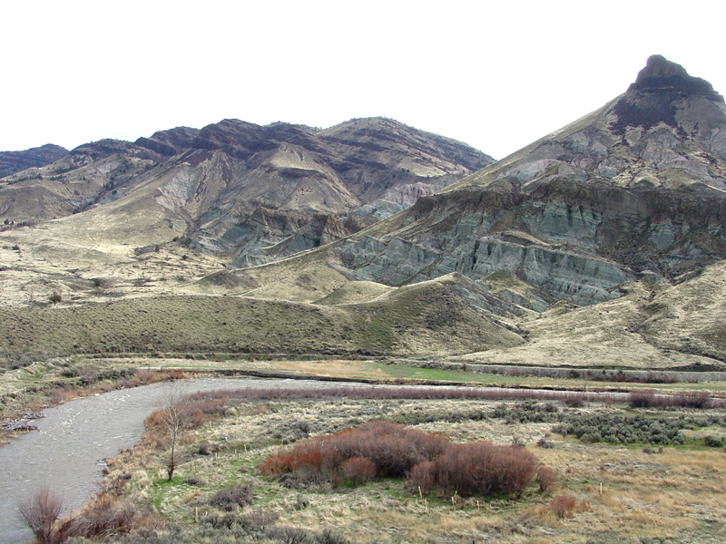
Plateau
Notes:
This view shows more detail of the John Day Formation and the overlying Picture Gorge Basalt exposed on the mountainsides north of Sheep Rock. In the foreground, erosion along the John Day River exposes Quaternary-age terrace gravels in the riverbank. This view is from the Sheep Rock Overlook along Highway 19.
U.S. Department of the Interior | U.S. Geological Survey
URL: https://3dparks.wr.usgs.gov/joda/html2/jd312.htm
Page Contact Information: Education Webmaster
Page Last Modified: 03-May-2017@08:55

Slide 29
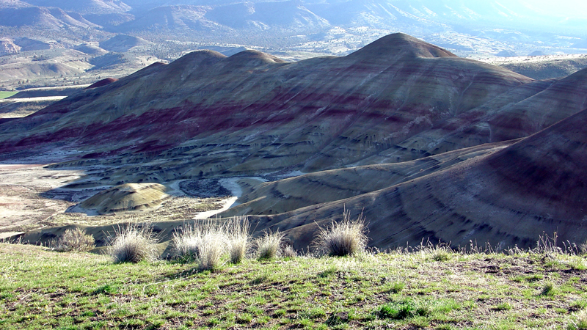
Plateau
Notes:
This view from the Painted Hills Overlook Trail shows beds of the John Day Formation gently folded into an anticline. The gray layers are mudstone, siltstone, and shale formed from sediments deposited on an ancient river floodplain. The black layers are thin beds of fossilized or carbonized vegetative matter (lignite) that formed in swamps on the floodplain. The red layers are ancient soil profiles (laterites) that formed on floodplain deposits (Bestland and others, 2002; Fremd and others, 1994). Surface weathering breaks down these rocks into a clay-rich surface coating that easily erodes during summer flash floods and/or winter storms. The high clay content and rapid erosion during infrequent storms prevents plants from becoming established in the badlands areas. Note the examples of native bunch grasses in the foreground.
U.S. Department of the Interior | U.S. Geological Survey
URL: https://3dparks.wr.usgs.gov/joda/html2/jd297.htm
Page Contact Information: Education Webmaster
Page Last Modified: 03-May-2017@08:55

Slide 30
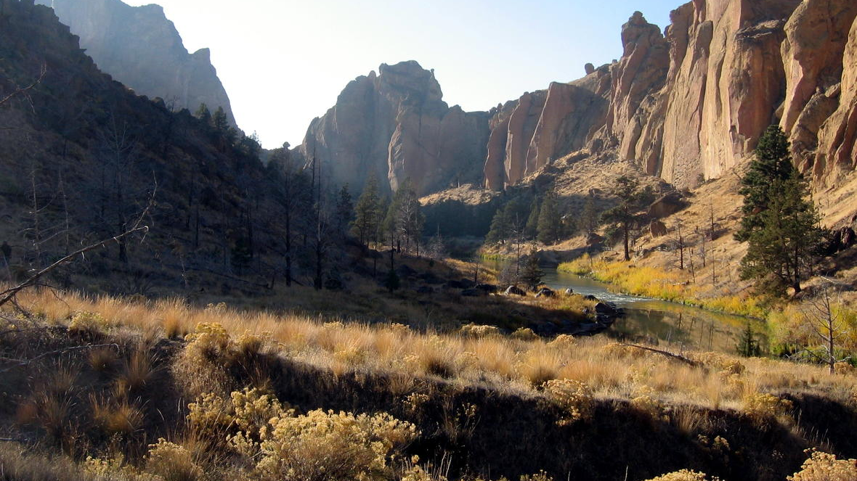
Plateau
Notes:
Crooked River of the Deschutes River Basin, Oregon, flows through Smith Rocks
(Credit: David S Morgan, USGS. Public domain.)

Slide 31
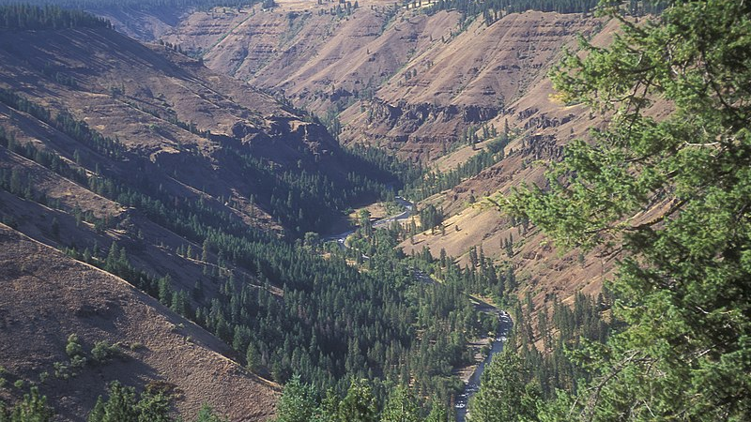
Plateau
Notes:
Umatilla-Umatilla Breaks and John Day river

Slide 32
Plateau Area
What do you notice?
What do you wonder?

Slide 33
Great Basin

Slide 34
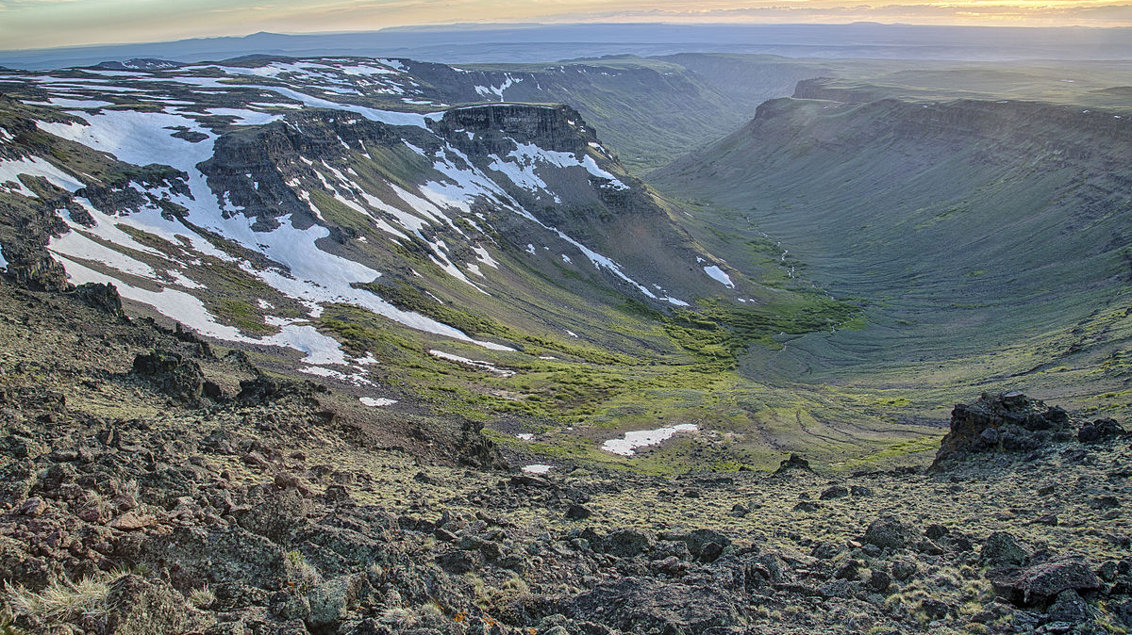
Great Basin
Notes:
Steens Mountain in eastern Oregon

Slide 35
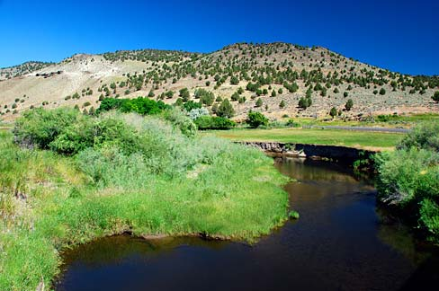
Great Basin
Notes:
The Malheur River at Drewsey.

Slide 36
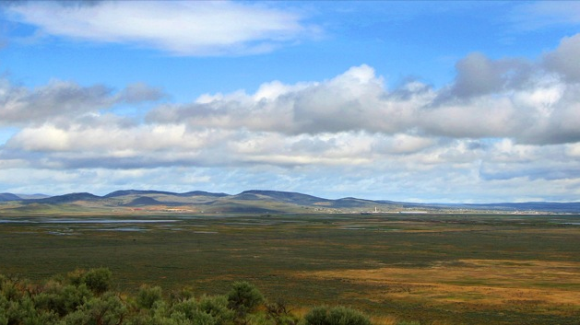
Great Basin
Notes:
Clouds over Harney Basin — near Burns, Great Basin region of Oregon.

Slide 37
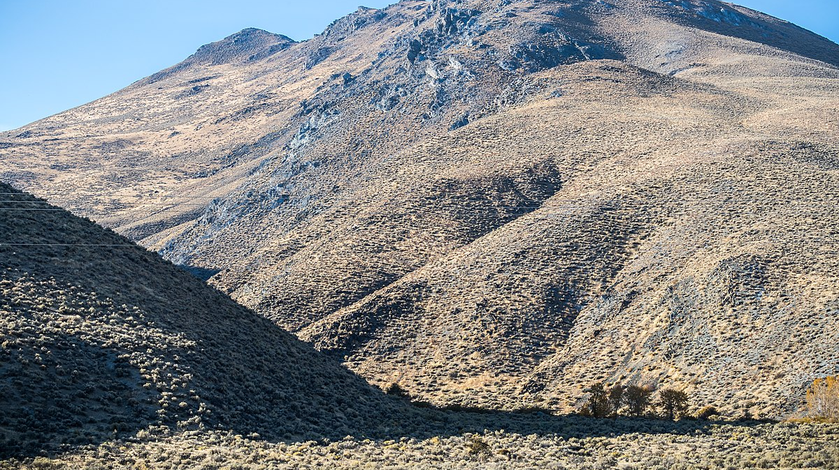
Great Basin
Notes:
The high desert sagebrush steppe conjoins the east side of the Pueblo Mountains and the the Pueblo Mountain Wilderness Study Area, Oct. 17, 2017, by Greg Shine, BLM.

Slide 38
Great Basin
What do you notice?
What do you wonder?

Slide 40
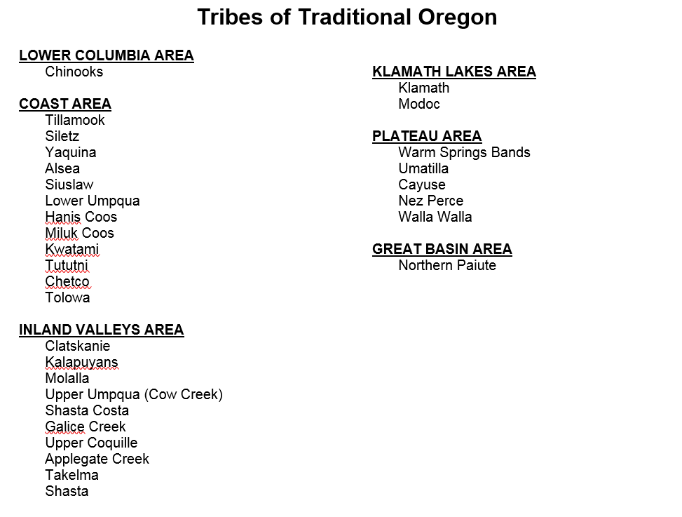

Slide 41
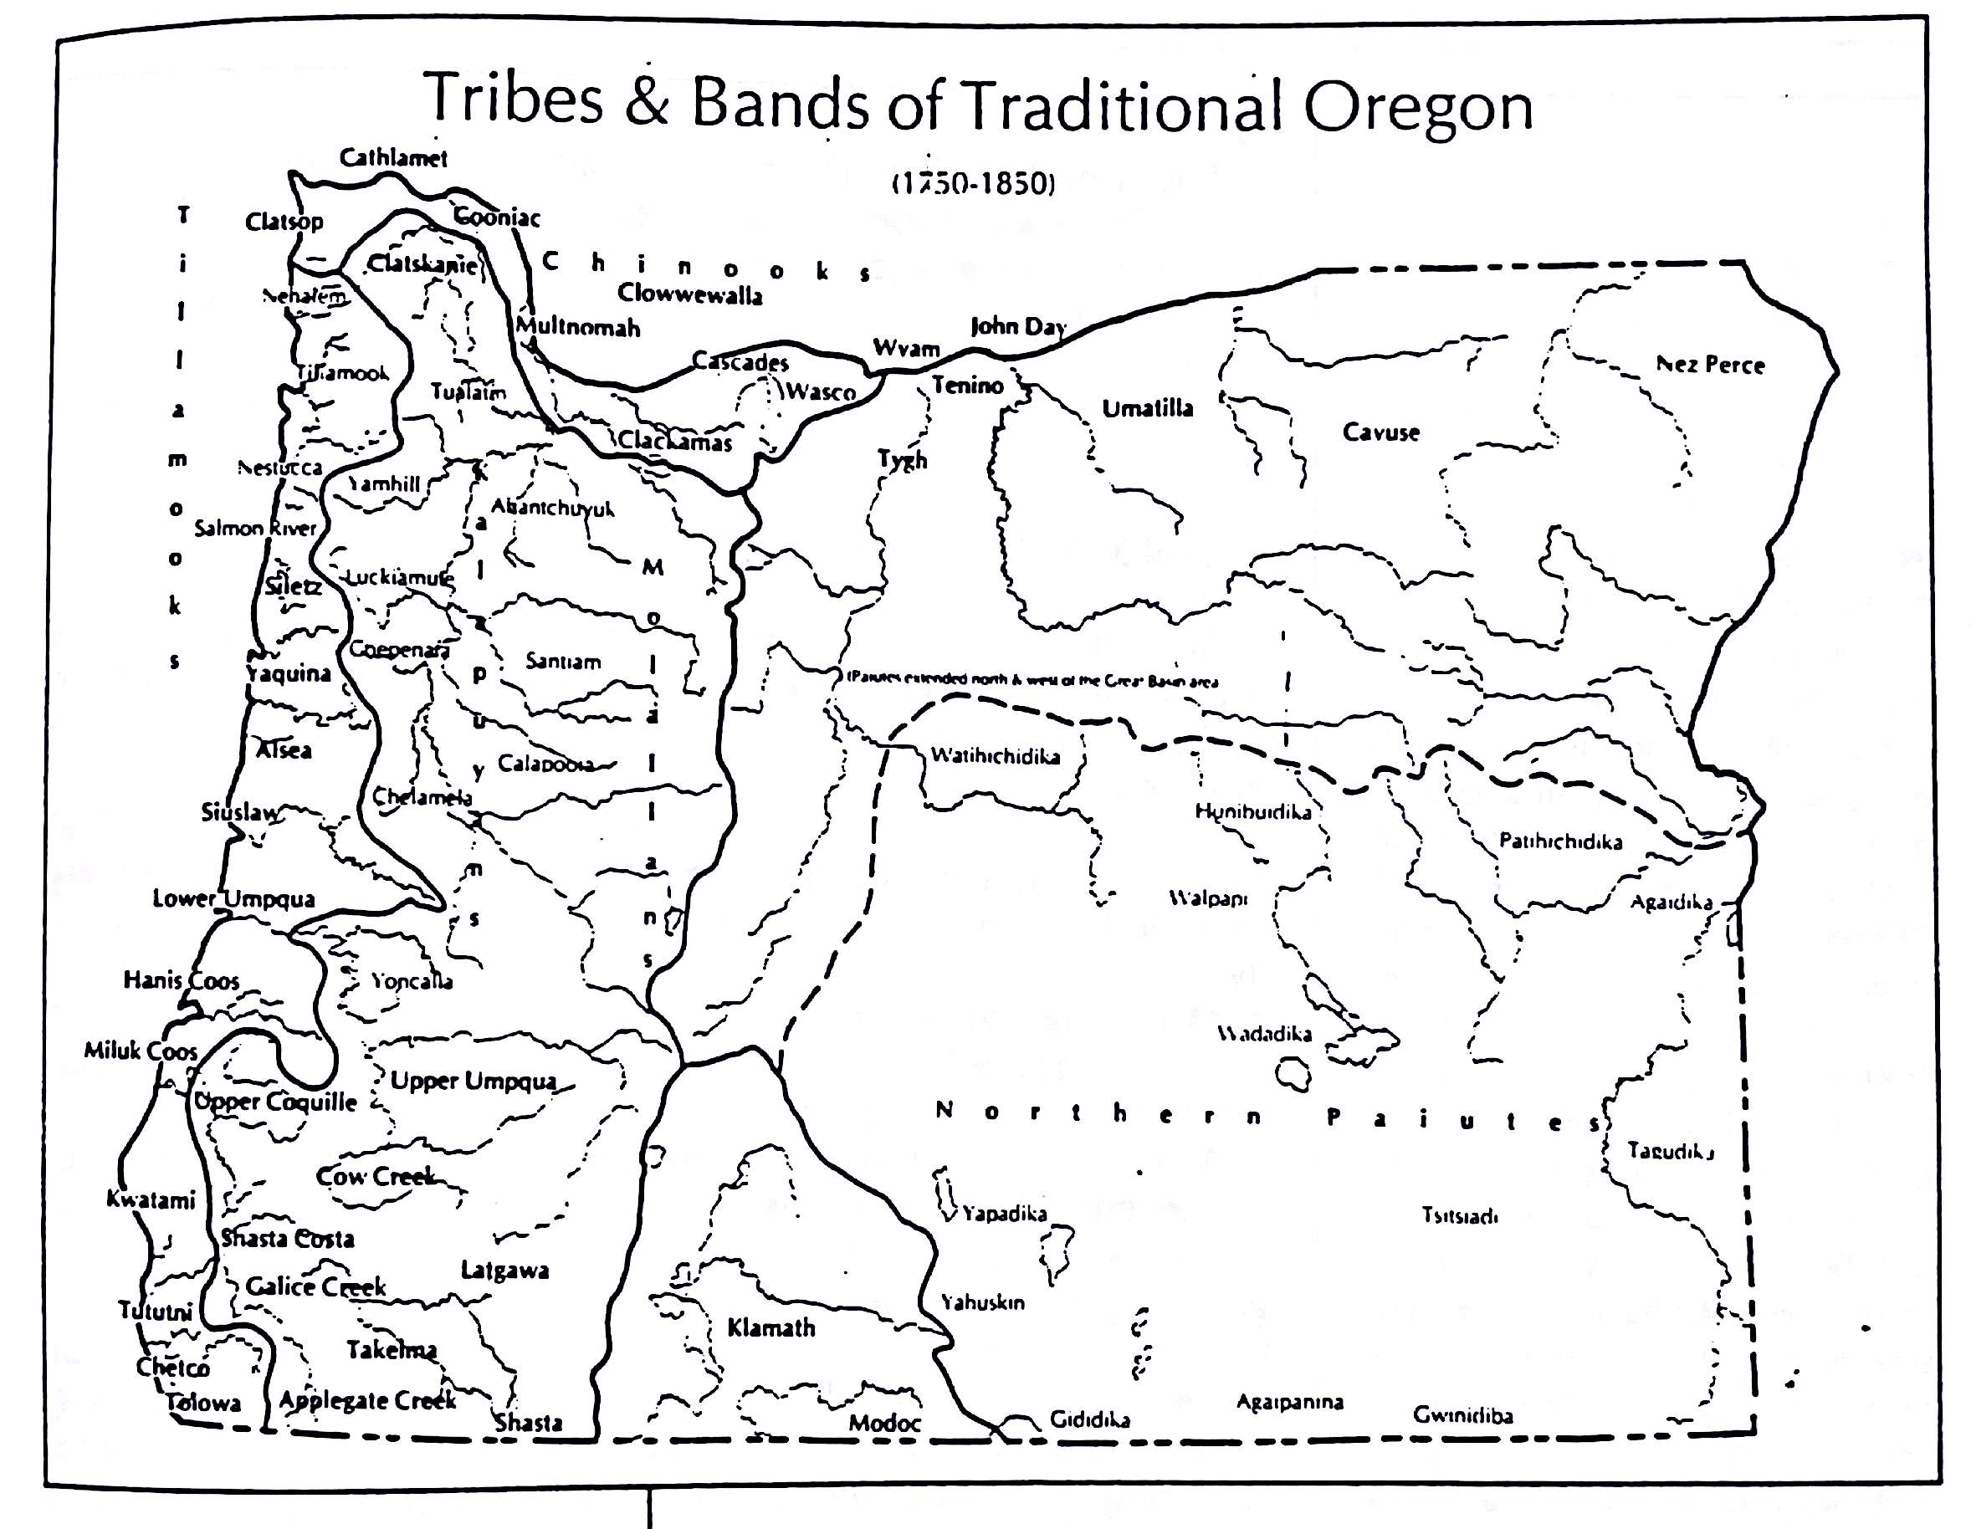
Notes:
Source: Oregon Indians Culture, History, and Current Affairs: an Atlas and Introduction (Jeff Zucker, Kay Hummel, and Bob Hogfoss, 1983)

Slide 42
