Slide 1
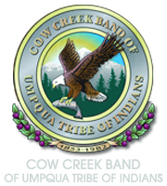

Lampreys

Slide 2
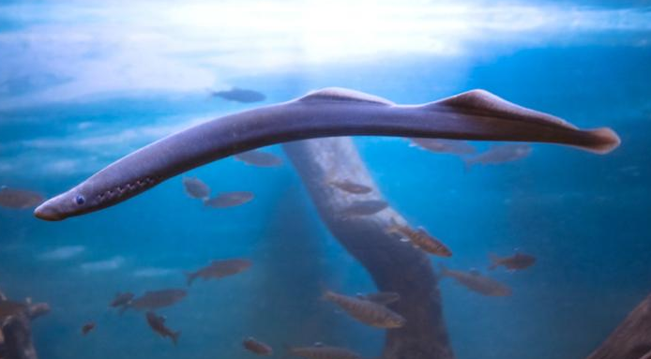
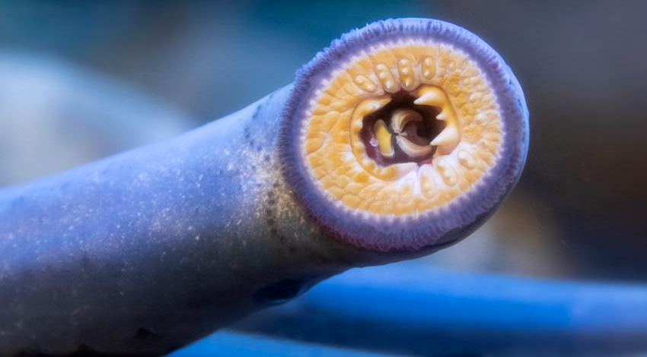
Meet the Lamprey
Images source: Oregon Zoo. Used with permission.

Slide 3
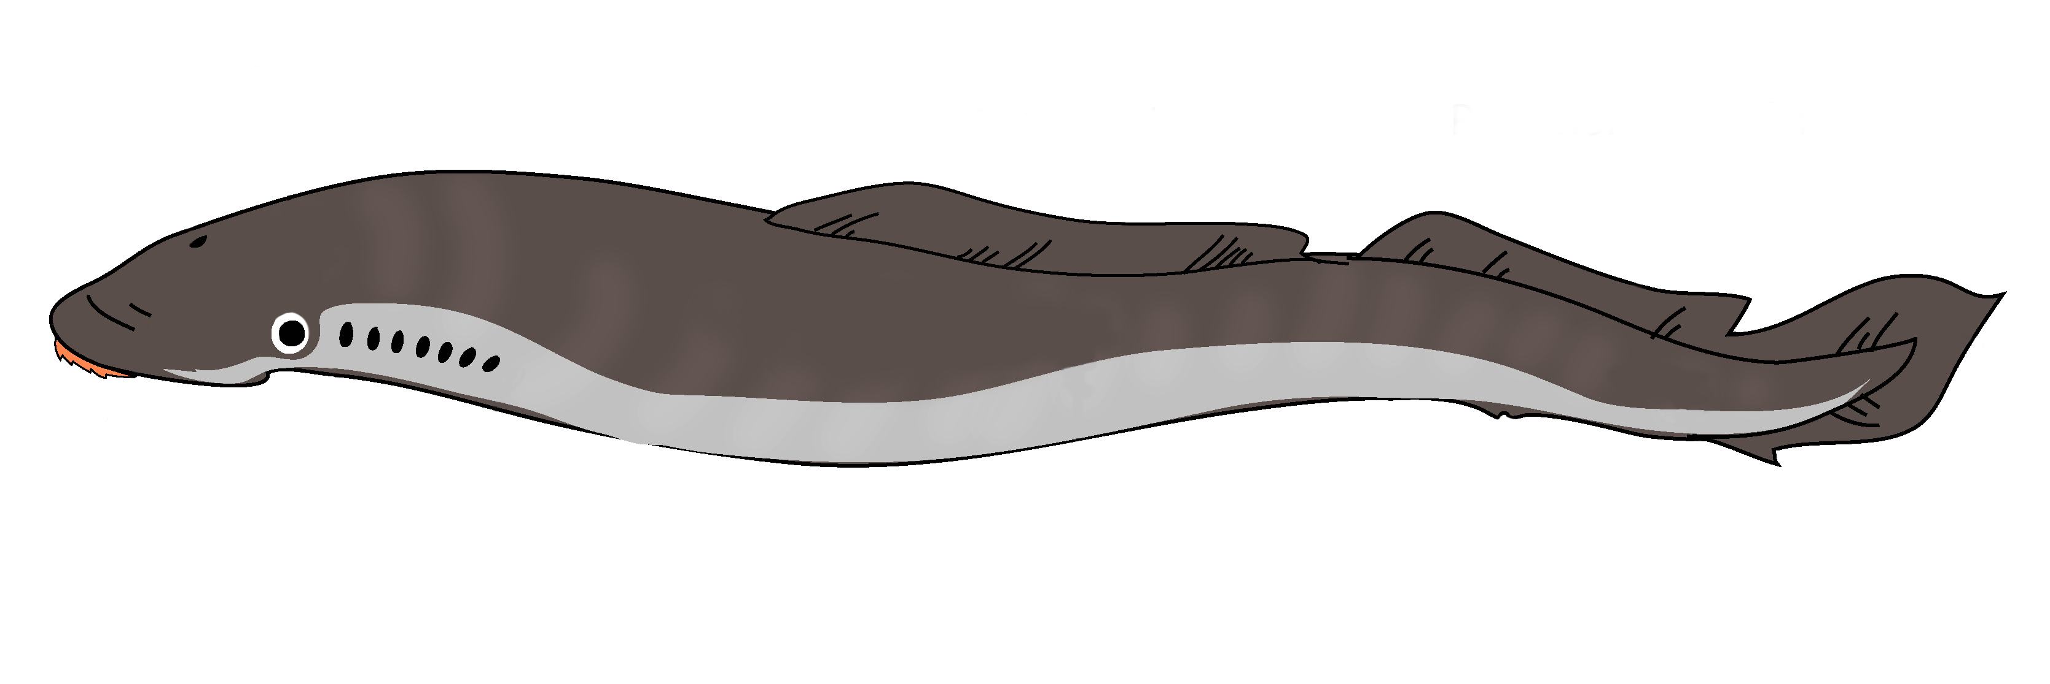
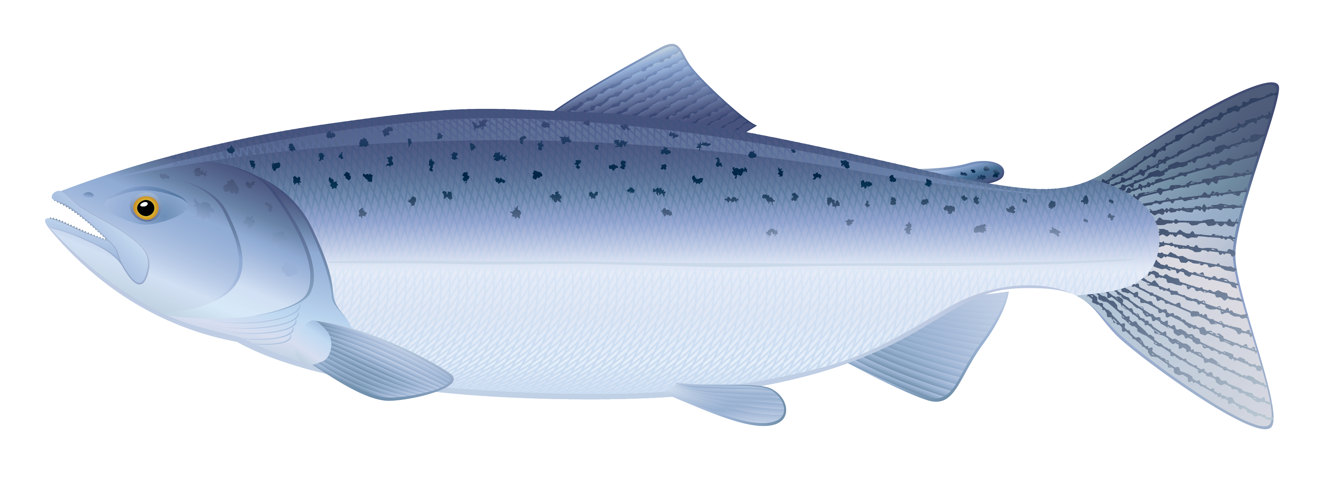
Lamprey vs. Salmon*
*Not to scale
Image sources: 1) Lamprey: Wikimedia Commons (fair use statement); 2) Salmon: iStockPhoto

Slide 4
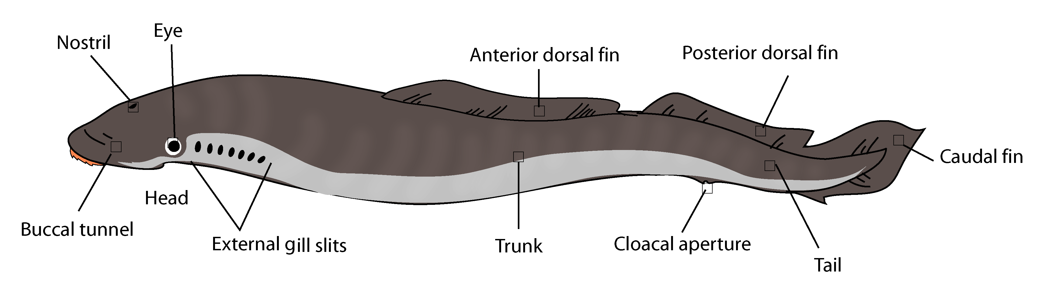
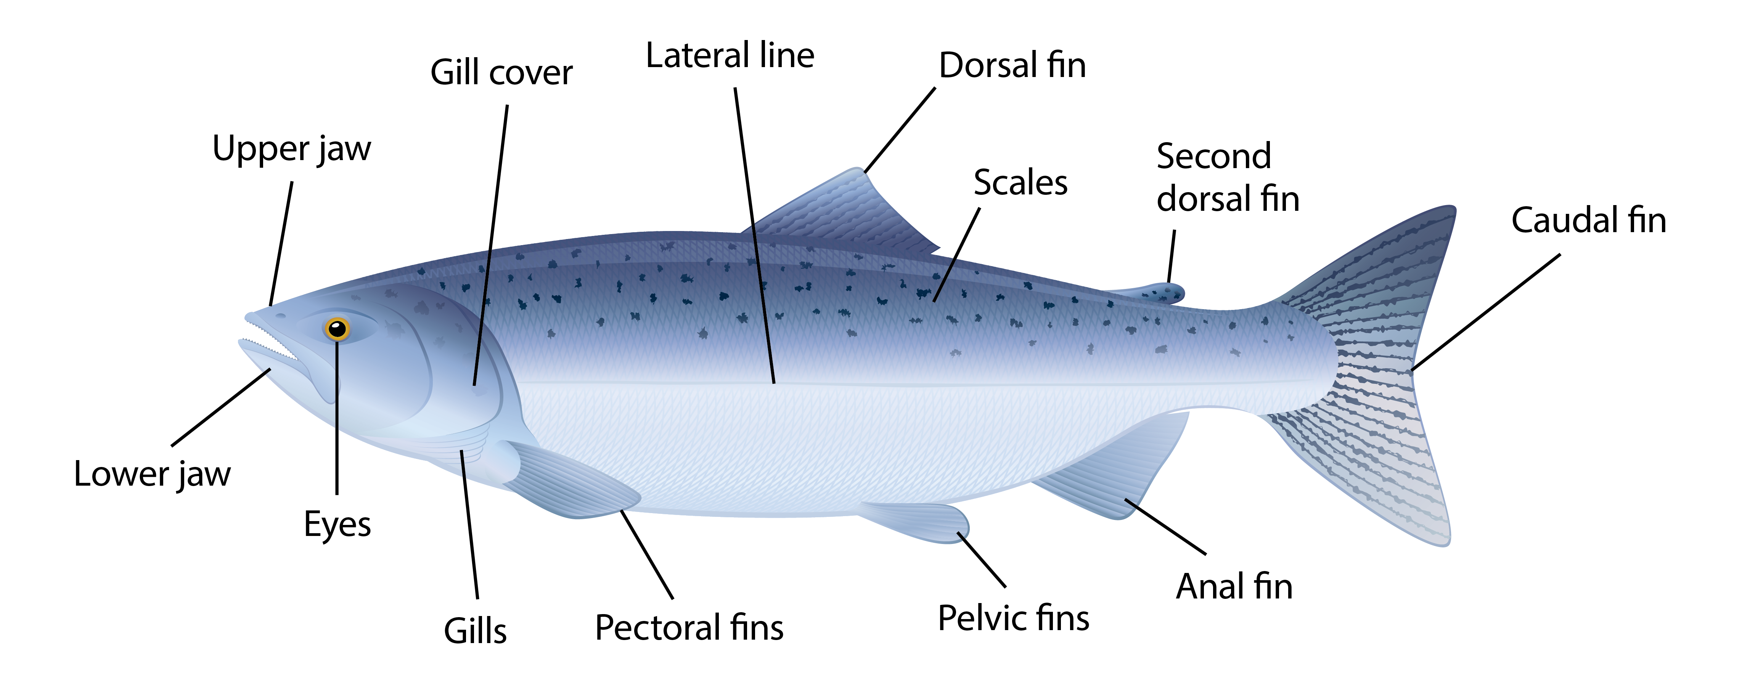
Lamprey vs. Salmon, Part 2*
*Not to scale
Image sources: 1) Lamprey: Wikimedia Commons (fair use statement); 2) Salmon: iStockPhoto

Slide 5
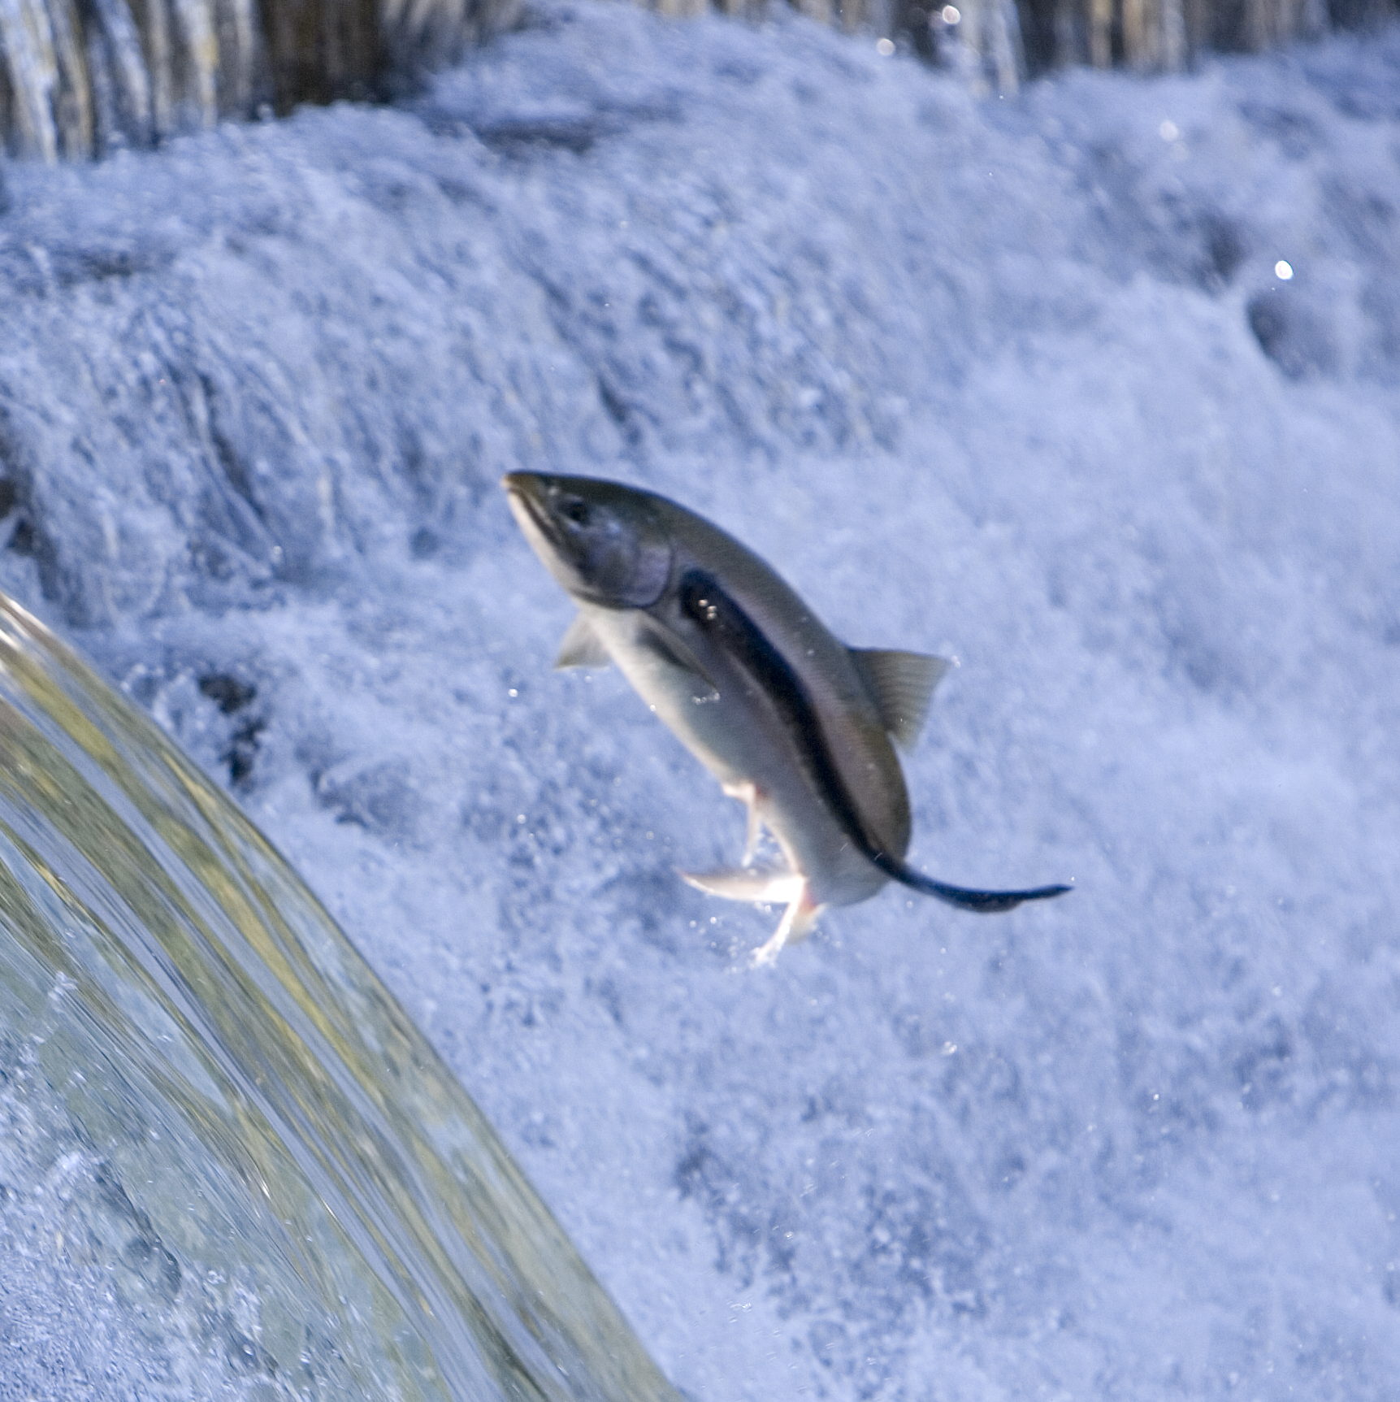
Lamprey vs. Salmon, Part 3
Image source: iStockPhoto

Slide 6
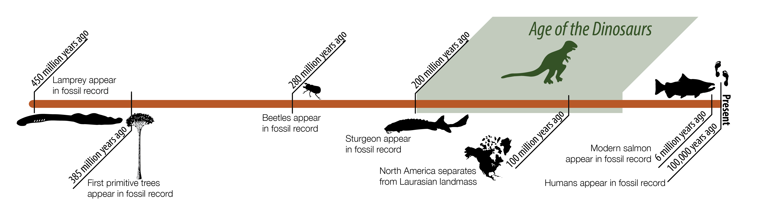
An Ancient Fish
Image source: Columbia River Inter-Tribal Fish Commission. Used with permission.

Slide 7
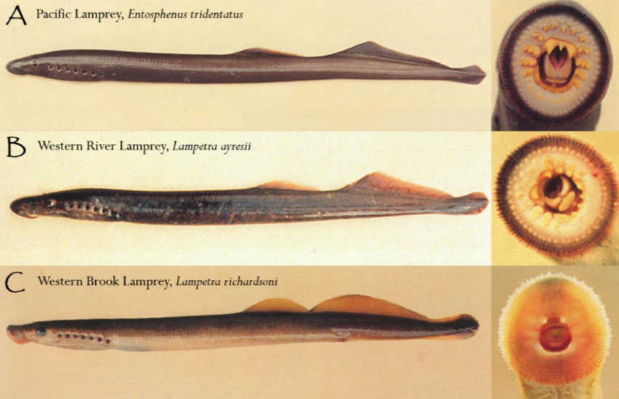
Lamprey Species In Oregon
Follett's Brook Lamprey (Northern California Brook Lamprey)
Goose Lake Lamprey
Klamath Lake Lamprey
Klamath River Lamprey (Klamath Lamprey)
Miller Lake Lamprey
Pacific Brook Lamprey
Pacific Lamprey
Pit-Klamath Brook Lamprey
Western Brook Lamprey
Western River Lamprey
Source: Oregon Department of Fish and Wildlife
Image source: Olmstead, J. (2019). Environmental DNA (eDNA) sediment sampling: A method for detecting larval lampreys in riverine habitat (Master's Thesis). Retrieved from https://www.dnr.wa.gov/publications/aqr_aamt_thesis_olmstead_2019.pdf. Adapted from Wydoski R. & Whitney R. (2003). Inland fishes of Washington. American Fisheries Society in association with University of Washington. 322 p. [28]. Used with permission.

Slide 8
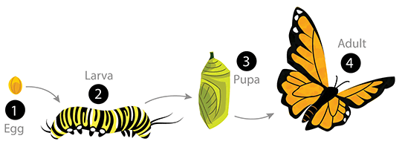
Metamorphosis
Image © Arizona Board of Regents / ASU Ask A Biologist. Creative Commons Attribution-ShareAlike 3.0 Unported License (details).
Image source: Baluch, P. (2011, April 29). Complete Metamorphosis. ASU - Ask A Biologist. Retrieved from https://askabiologist.asu.edu/complete-metamorphosis

Slide 9
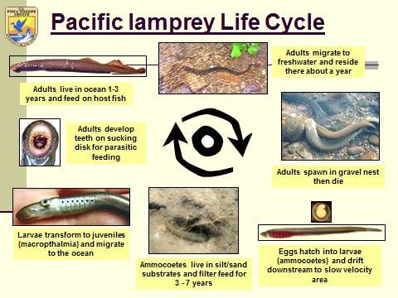
Pacific Lamprey Life Cycle
Image source: U.S. Fish and Wildlife Service. Public domain.

Slide 10
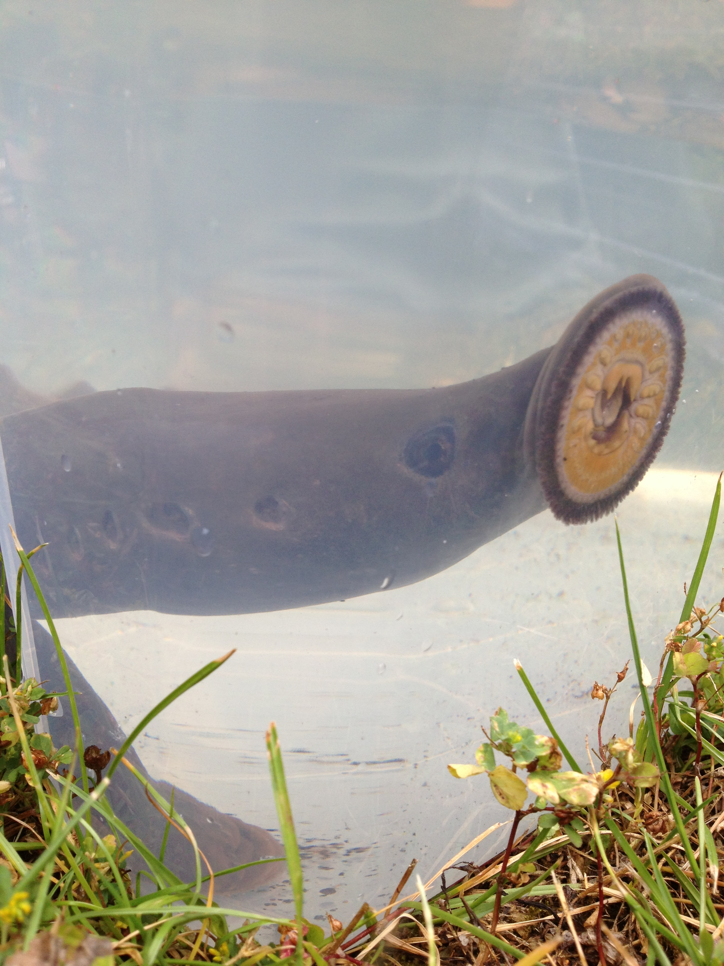
Lampreys and the Cow Creek Tribe
Xtáan is the name for lamprey in Takelma, the language of the Cow Creek Tribe
Cow Creek people fished for lampreys in the Umpqua River watershed for thousands of years
Lampreys were described as good singers, since their breathing holes resembled flute holes
Lamprey were and still are a “first food” of the Cow Creek Tribe and others.
  They are a good source of protein and can be dried or smoked and stored for the winter.
  They also yield an oil that can help keep hair and skin healthy
Image source: Cow Creek Band of Umpqua Tribe of Indians

Slide 11
How Lamprey Lost His Bones
"One day the lamprey met the salmon. They started to gamble. The game was one of sticks, as your fathers play, betting on how many robes or furred switches the other holds. The lamprey, who was very lucky, won for a long time. Then he became careless. He bet recklessly. The salmon began to win. The lamprey lost all he had won. Then he lost all he had of wealth. When he lost everything, he bet his bones. Again the salmon won. That is why to this day the lamprey has no bones.”
Source: Bakken, L. (1970). Lone Rock Free State: A collection of historical adventures and incidents in Oregon's North Umpqua Valley, 1850 to 1910.
Myrtle Creek, OR: The Mail Printers.

Slide 12
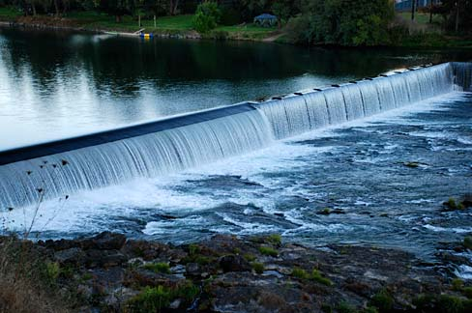
Looking Out for Lampreys
The Cow Creek Tribe is working with state and federal agencies and private landowners to study and protect lampreys through:
  Studying, tracking, and counting lamprey
  in streams and rivers
  Restoring damaged lamprey habitat
  Designing lamprey ramps and other devices
  to help lampreys get around obstacles
  Working to remove dams and culverts that
  are no longer useful
Image source: Gary Halvorson, Oregon State Archives (via Wikimedia commons; fair use statement)

