Slide 1
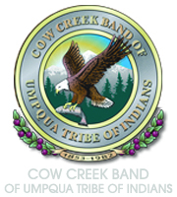

Traditional Games

Slide 2
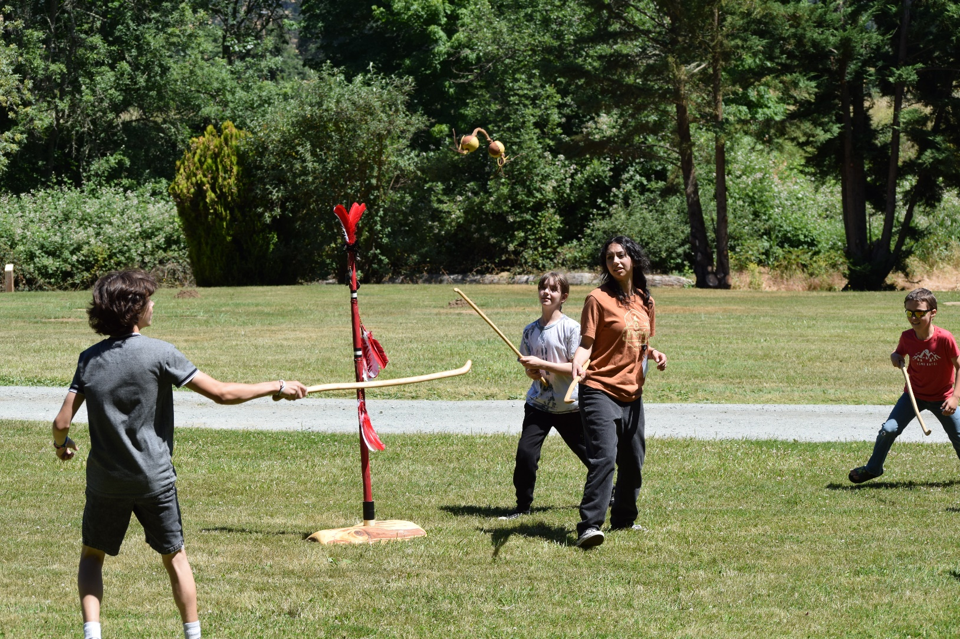
Name this game
What do you think/wonder/
notice about the game being played in the picture?
Does it look like other games you know of?
What do you think the game is called?
Image source: Cow Creek Band of Umpqua Tribe of Indians

Slide 3
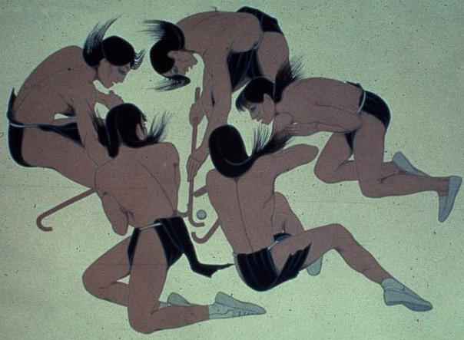
Shinny basics
Ball-and-stick game
Like modern-day field hockey
Played by Tribes all over North America
Different Tribes use different materials and rules
Played by men and women
Played for fun and/or as part of ceremonies and celebrations
Image source: HockeyGods.com. Used with permission.
Notes:
Say:
Shinny is a ball-and-stick game like modern-day field hockey. The goal of shinny is to strike or loft a ball with a stick to move it toward a goal. It was and continues to be a popular sport among Native American Tribes all over North America. While the basic strategy of the game is the same, different Tribes used different materials to create the sticks and balls and followed different rules for playing the game. Shinny was played by both children and adults. For adults, it could be played by women or men alone, by men and women together, or by men against women. The game could be played for fun and entertainment, be incorporated into ceremonies or special occasions, or be used to ease tensions between different groups instead of fighting each other.
Shinny sticks were fashioned from saplings or branches of local trees, and the ball could be made of wood, buckskin, bark peelings, or woven. Pacific Coast and Southwestern Tribes typically used a wooden ball, while Eastern and Plains Tribes used buckskin balls. Balls could be a single ball or two balls tied together. Goals were set at varying distances and could consist of one or two posts at each end of the playing area, blanket goals, or “hole in the ground” goals. The ball cannot be touched with the hands but rather is batted or lofted with a stick (and, in some variations, kicked with the feet) toward the goal.

Slide 4
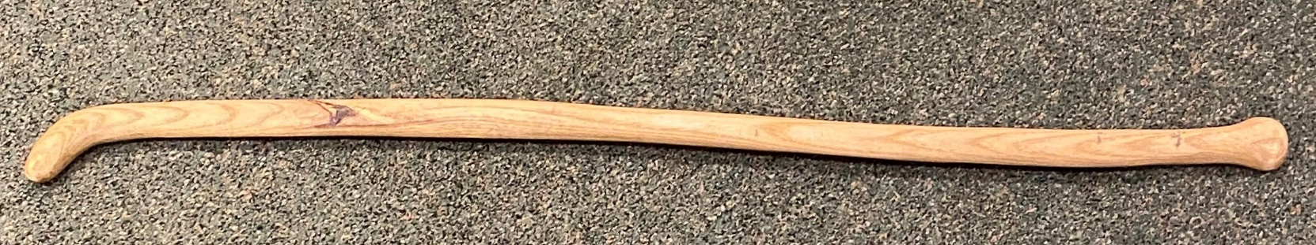
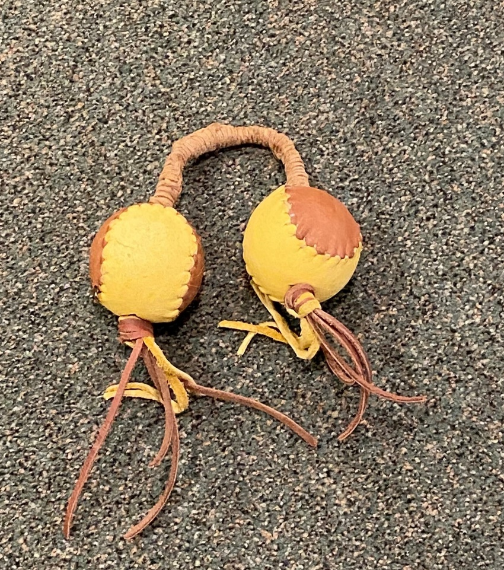
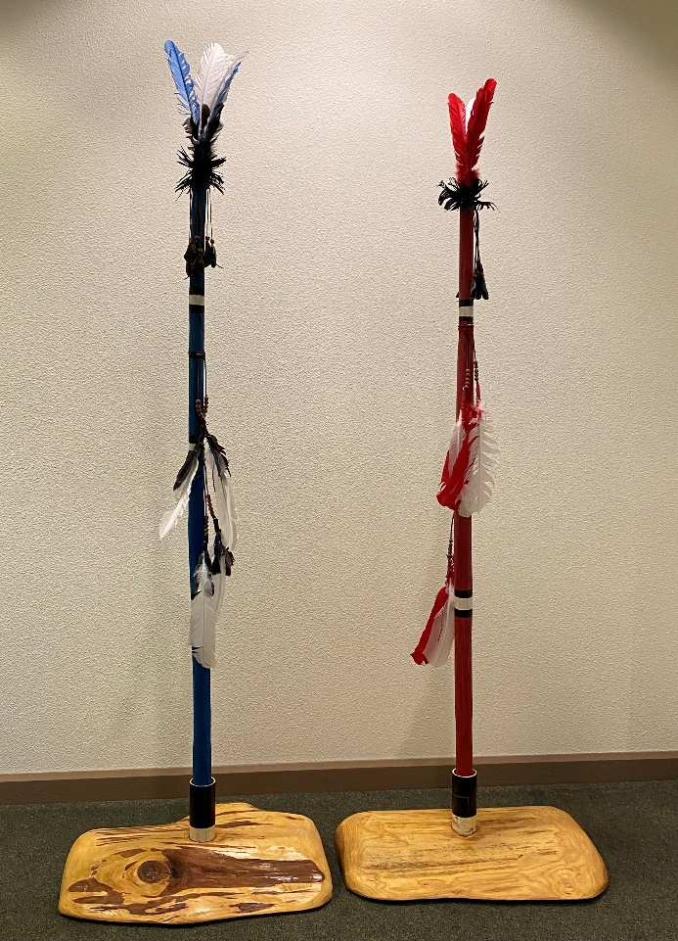
Cow Creek-style shinny
Stick (t'elá): Made from hardwoods with
tight grain
Ball (t^{h}peèk^{h}w): Oak pieces tied together
Goal (Póow): Vertical poles with feathers and noisemakers
Field: Any flattish area; length depended on who was playing
Players: Anyone could play for fun; men only played when it was used to replace fighting and competition between groups
Rules: Varied based on age range and size
of playing area
t'elá [t’-eh-LAH]
t^{h}peèk^{h}w [t-BEH-kw]
Póow [BOH]
Image source: Cow Creek Band of Umpqua Tribe of Indians
Notes:
Say:
The Cow Creek people played shinny using hardwood sticks and oak staves tied together. Goals were vertical poles posted at both ends of a playing area. Each pole had feathers and noisemakers attached so that it was clear when a goal had been scored. Anyone could play the game for fun, but only men played if the game was used to ease tensions and reduce fighting and competition between groups. Rules varied based on the age of the players and the length of the playing area; it could be played in a small clearing or across a miles-long valley.

Slide 5
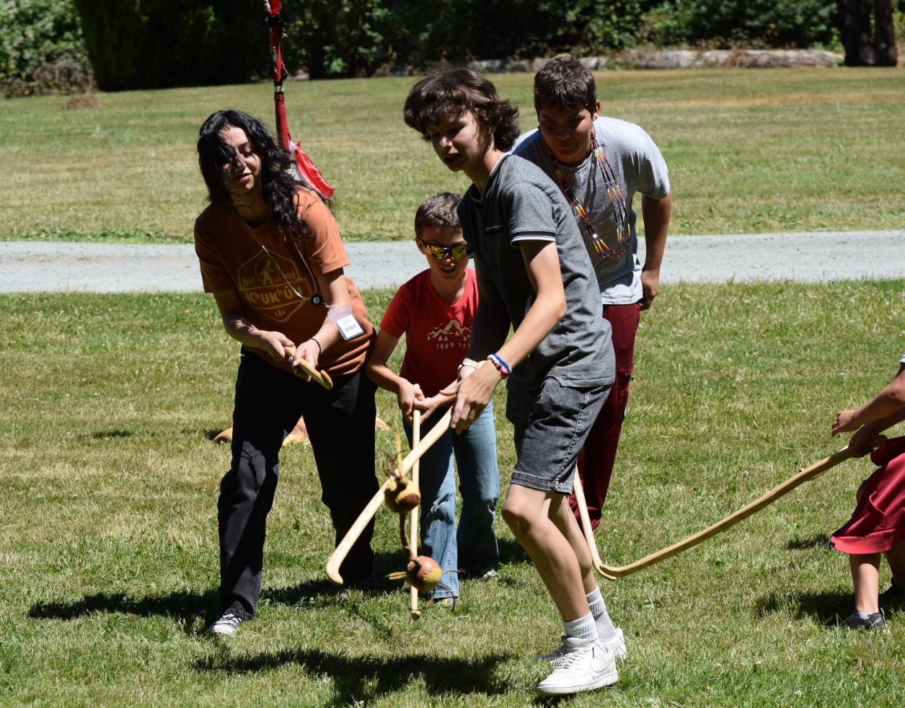
CCBUTI and shinny today
The Cow Creek Band of Umpqua Tribe of Indians teaches Tribal members to play shinny
Some modern materials are used for convenience and safety
Playing shinny promotes physical fitness and teamwork and maintains ties to Tribal history and traditional practices
Image source: Cow Creek Band of Umpqua Tribe of Indians
Notes:
Say:
The Cow Creek Band of Umpqua Tribe of Indians teaches Tribal members how to play shinny—with some adaptations and modern materials for convenience and safety, such as using tennis or whiffle balls instead of oak staves—as a fun recreational activity that promotes physical fitness and teamwork while maintaining ties to Tribal history and traditional practices.

