Slide 1


Survivance Gallery Walk

Slide 2
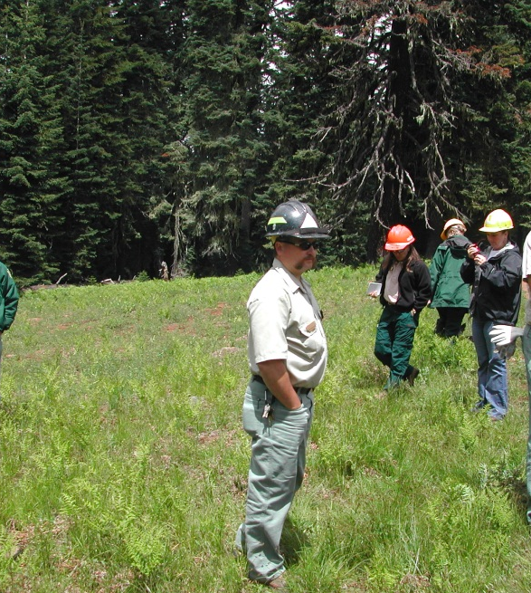
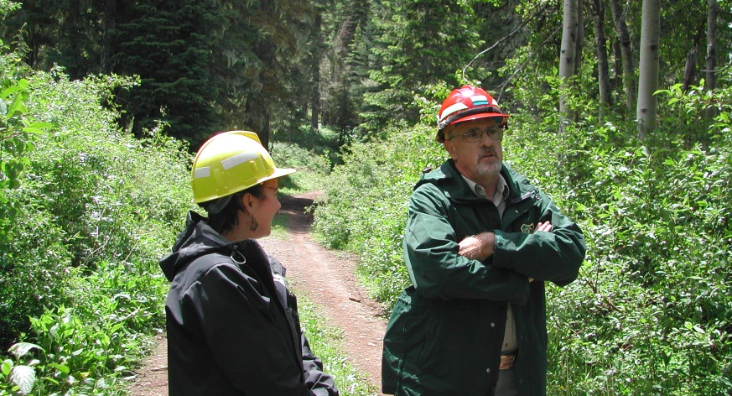
Poster 1
In January 2004, staff members from the Umpqua National Forest met with the Cow Creek Band of Umpqua Tribe of Indians to discuss modifying the Rogue and Umpqua National Forest Plans to classify over 9,000 acres of huckleberry patch as
a “Special Interest Area” (SIA).
On January 24, 2006, the Supervisors of both the Umpqua and the Rogue National Forests issued their decision, designating 9,461 acres as the Huckleberry Patch SIA.
The designation will allow the Forest Service
to propose projects in the future that focus on maintaining and enhancing huckleberries, so
that traditional, historic, and present-day uses
may continue.

Slide 3
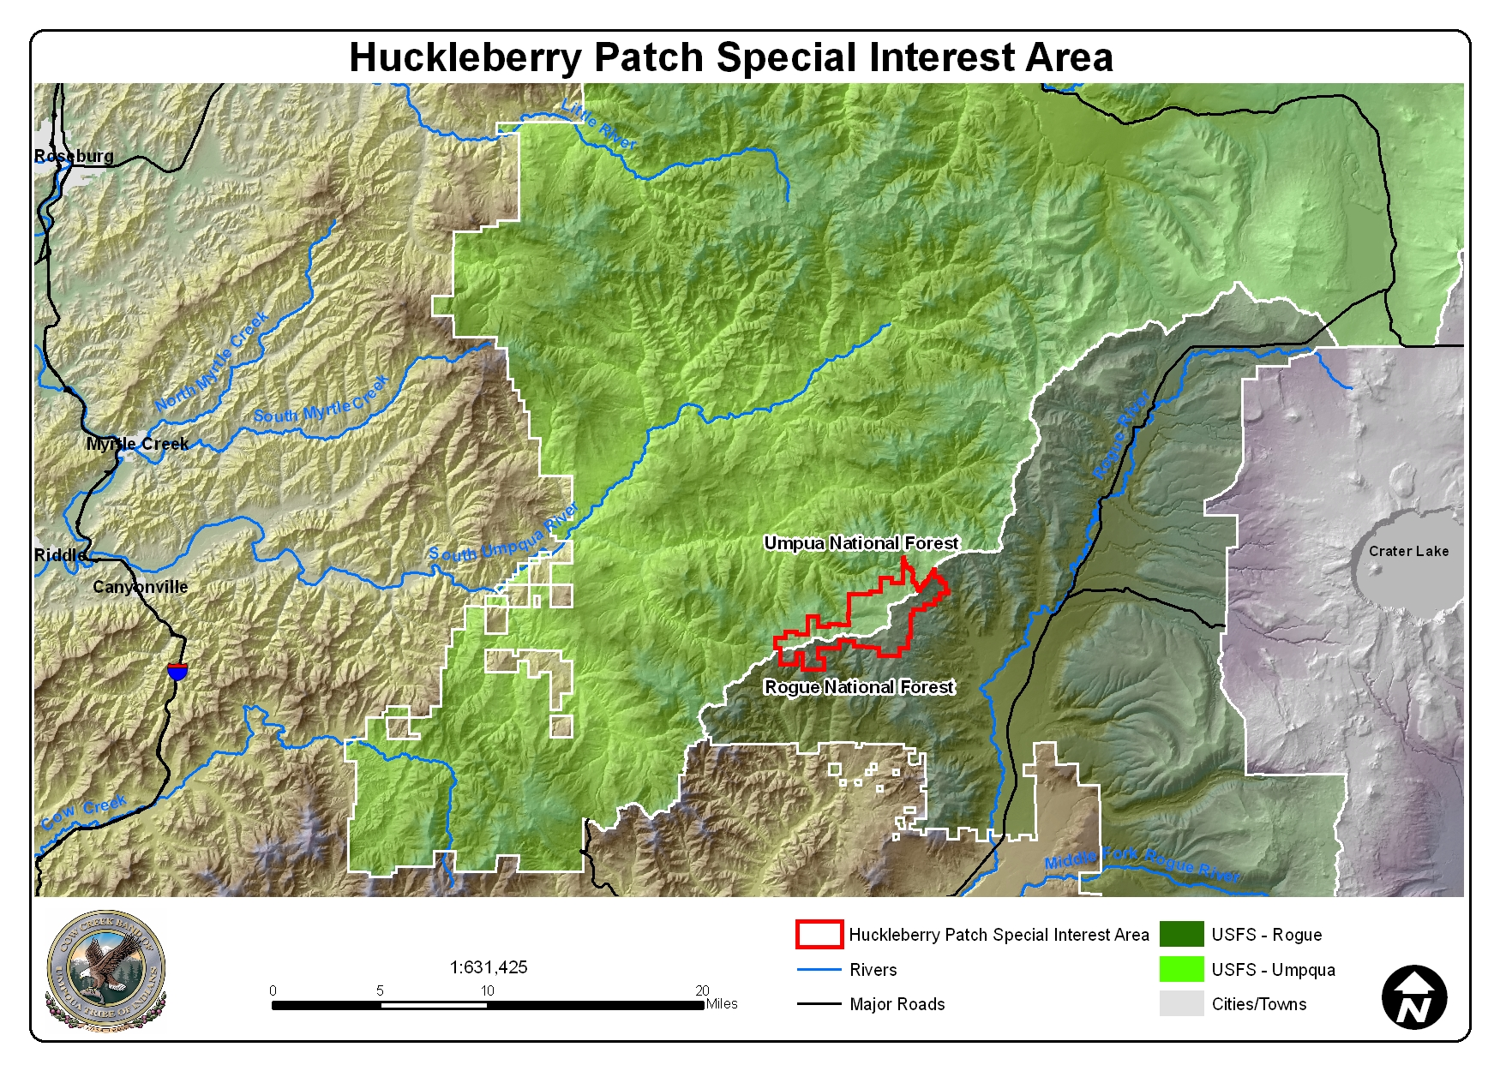
Poster 1

Slide 4
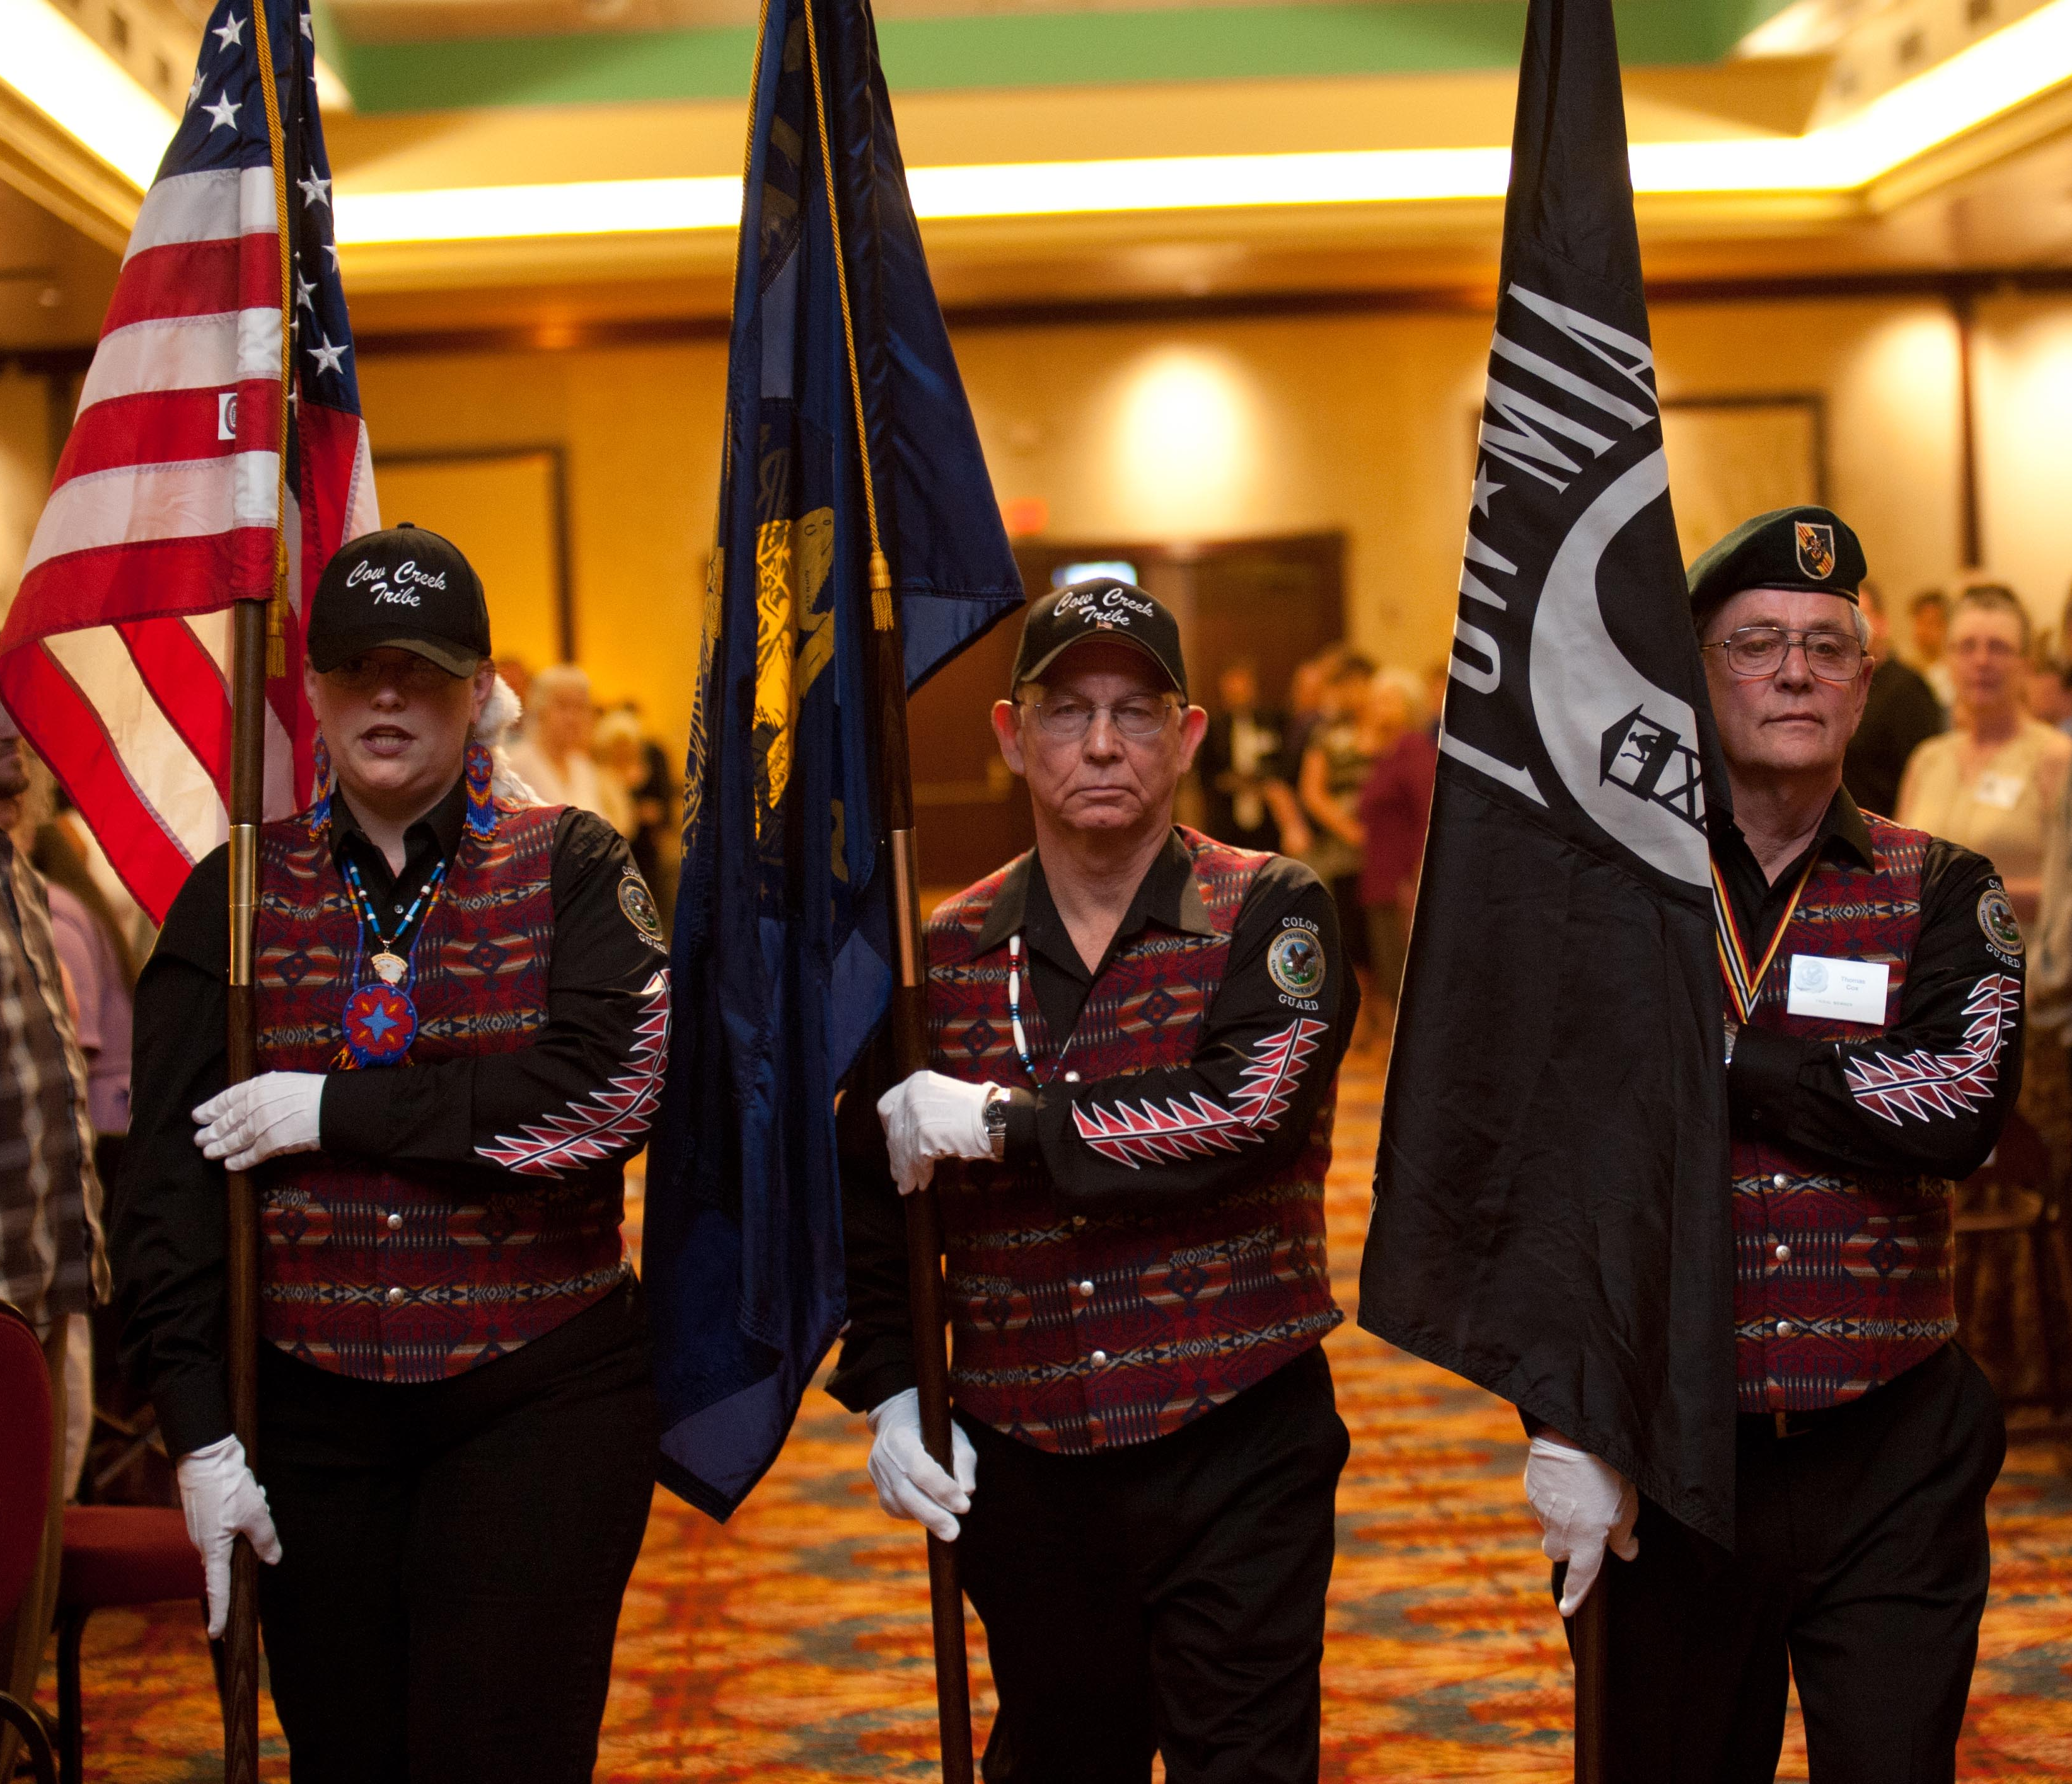
Poster 2
The Cow Creek Tribe hold their warriors in high honor. The Cow Creek Veteran Group meets regularly and supports the community by participating in events.

Slide 5
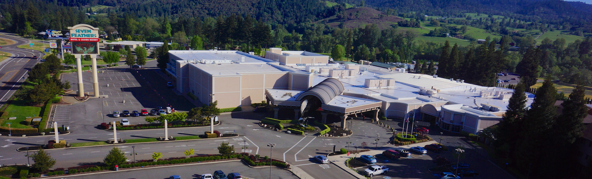
Poster 3
The Seven Feathers Casino Resort is owned by the Cow Creek Band of Umpqua Tribe of Indians. It is the largest facility of its kind in Southern Oregon and attracts over one million visitors annually. The casino was originally opened as the Cow Creek Bingo Hall in 1992. The income raised through the casino supports multiple Tribal programs including family support services, cultural awareness, and education.
Seven Feathers Casino celebrated its 30th anniversary in 2022!

Slide 6
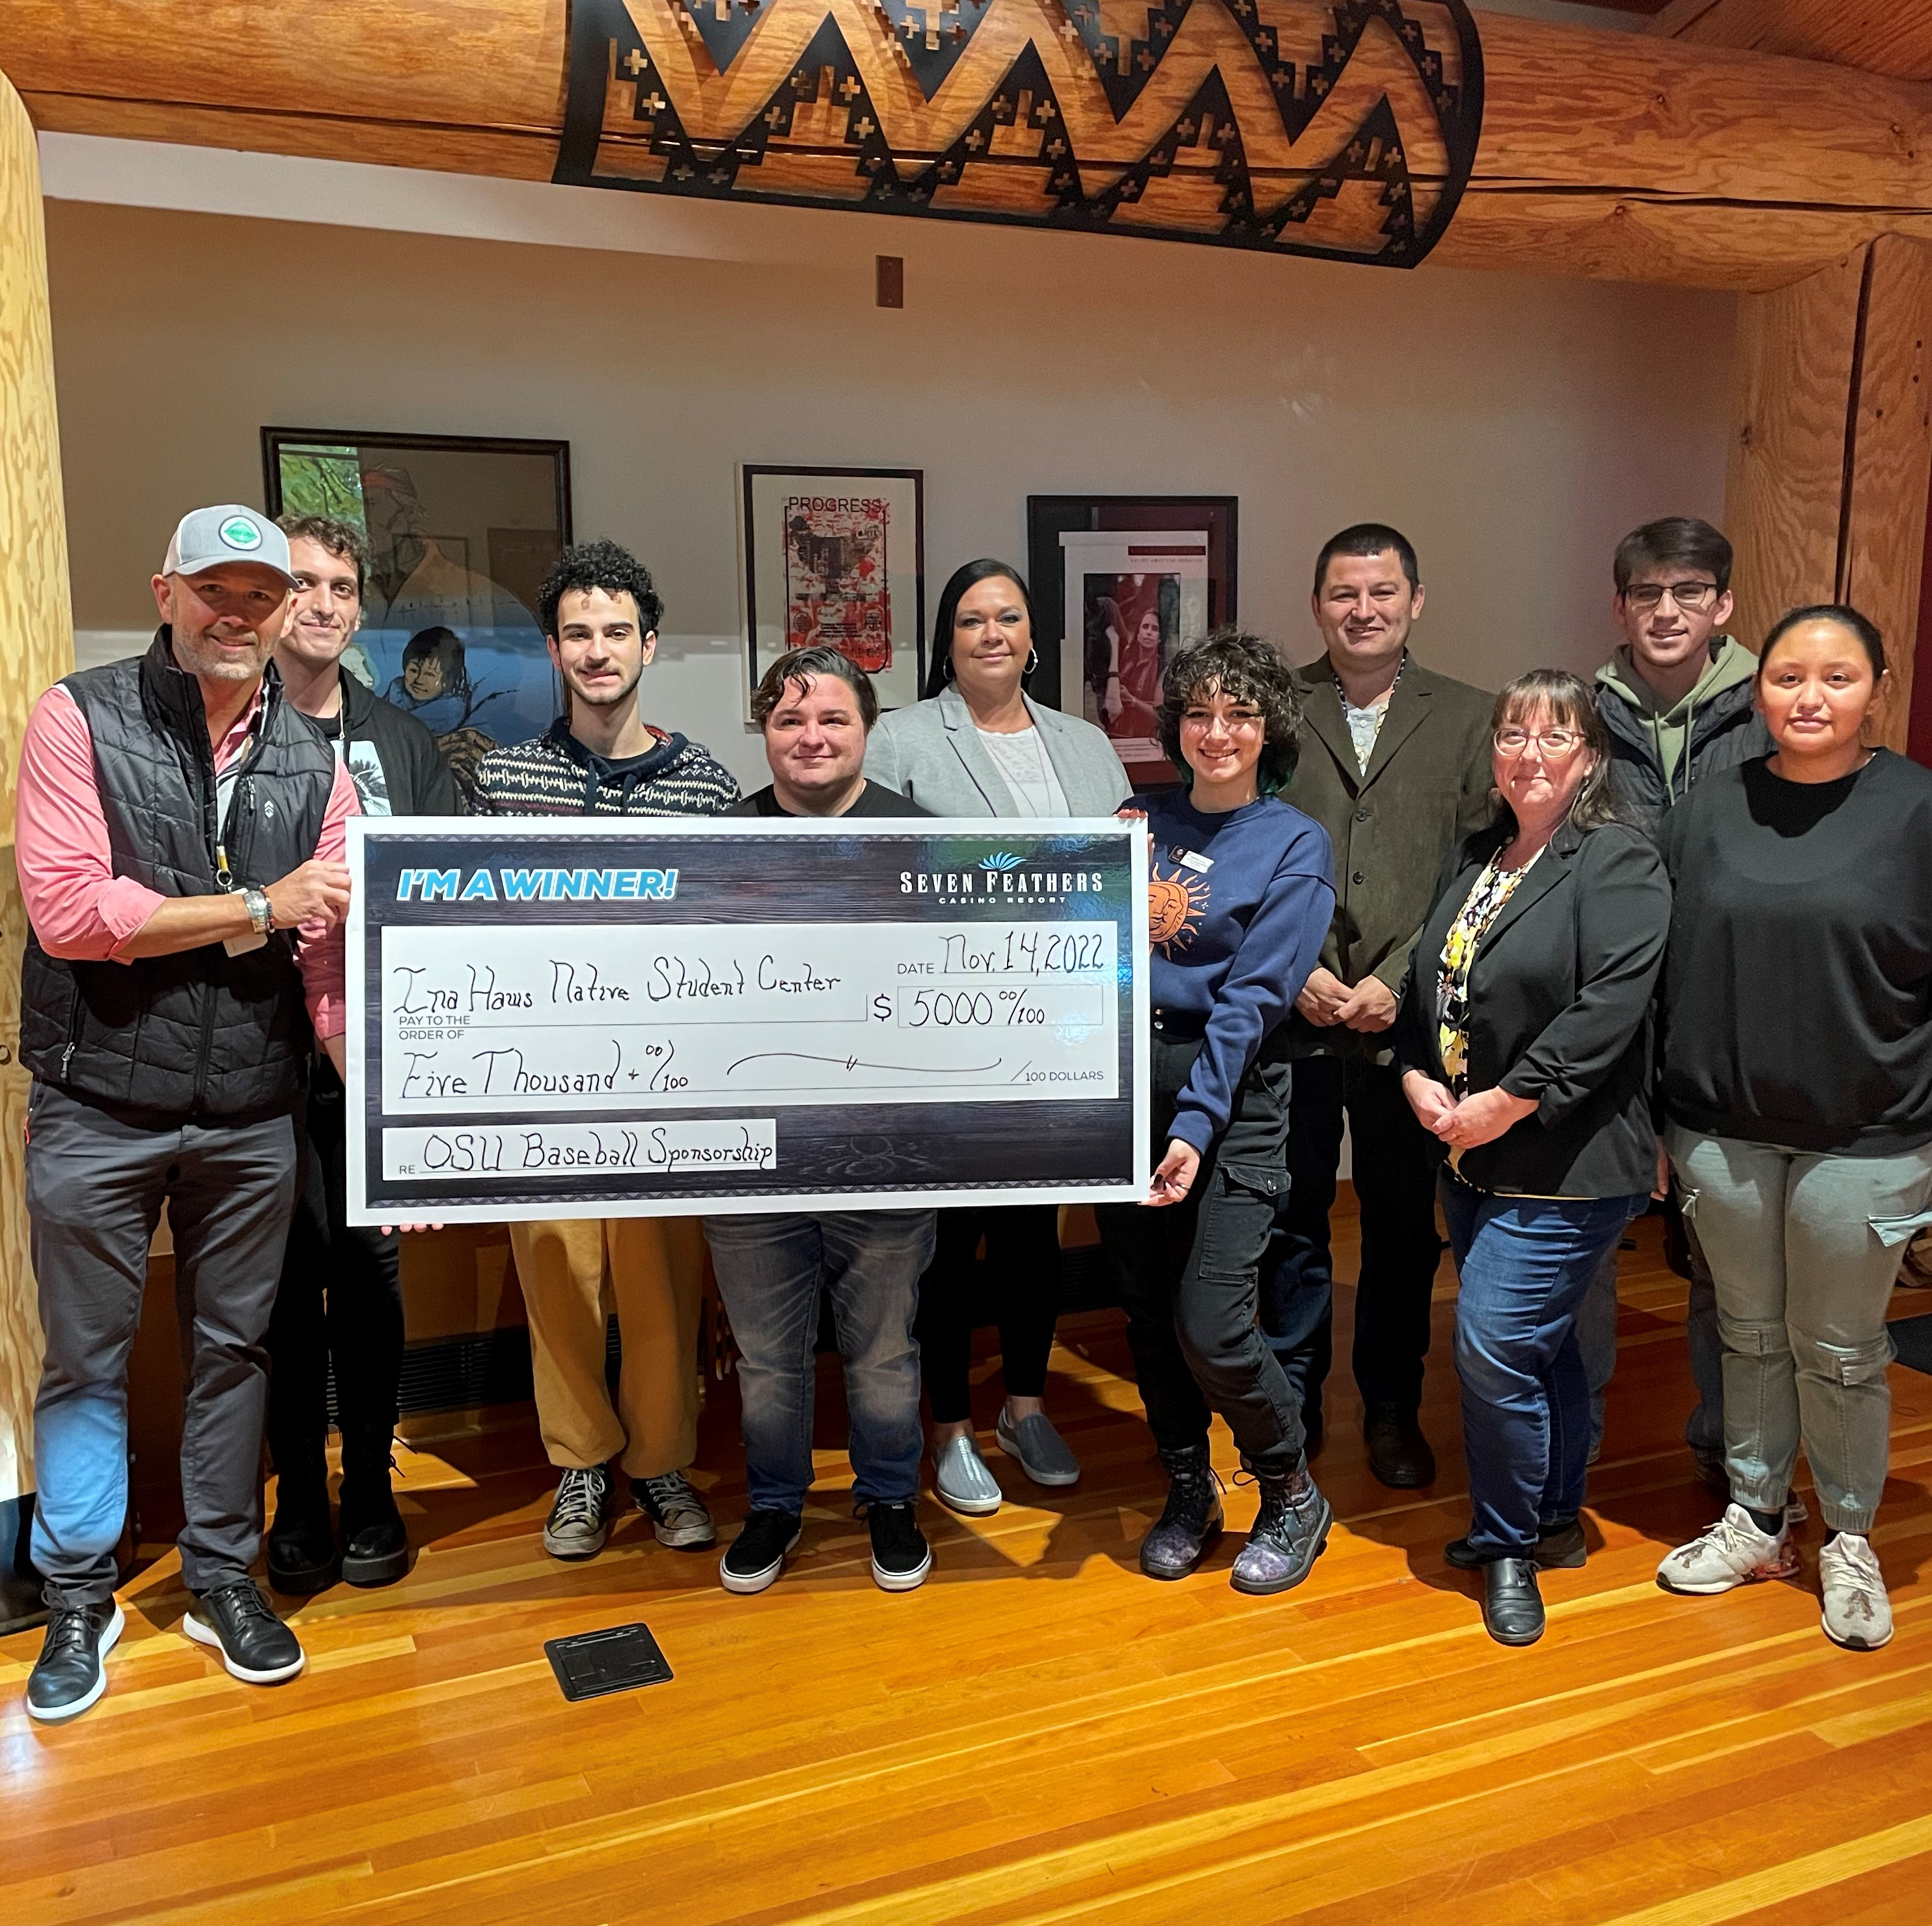
Poster 4
The Cow Creek Band of Umpqua Tribe of Indians participates in multiple philanthropic projects.
For example, the Tribe partnered with the Oregon State Beavers baseball team to raise funds to support the Eena Haws Native Student Center. The Eena Haws was opened in 2013 as an Indigenous-based center on the Oregon State University Campus. The Eena Haws supports Native students in their academic journeys.

Slide 7

Poster 5
Umpqua Indian Development Corporation (UIDC) is the Cow Creek Tribe’s primary economic development engine. Under its auspices, the Tribe operates several businesses for the benefit of Tribal members, local residents, and the surrounding community. UIDC is a federally chartered corporation.

Slide 8


Poster 5
UIDC is the business division of the Cow Creek Band of Umpqua Tribe of Indians—the most diverse employer in Douglas County!

