Slide 1
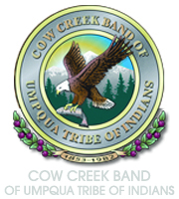

Wetlands

Slide 2
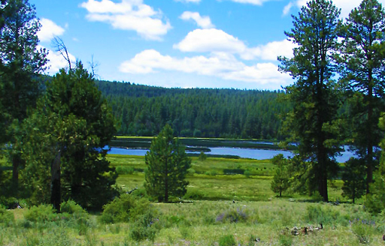
What is a wetland?
A wetland is an area of land that is saturated with water. Common names for wetlands include estuaries, marshes, swamps, bogs, fens, mudflats, and floodplains.
Image source: U.S. Fish & Wildlife Service

Slide 3
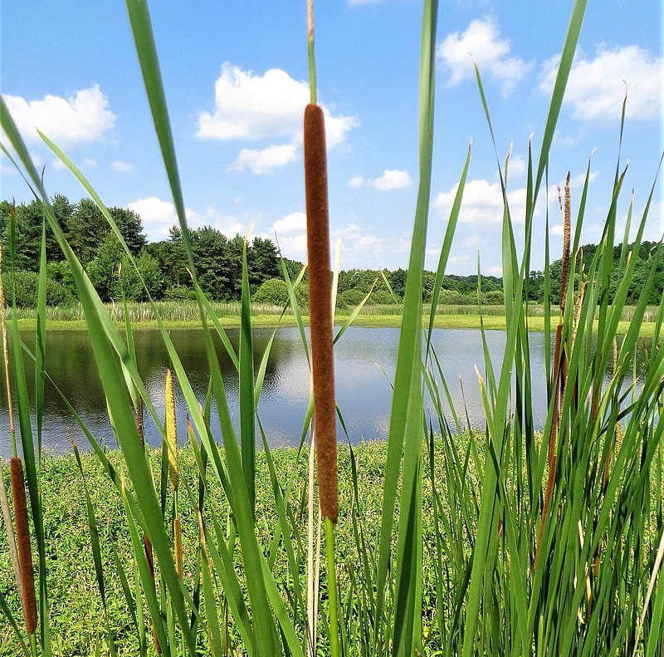
What are characteristics of wetlands?
Wetlands are characterized by hydric (water-saturated) soil, and plants that grow in or on water (hydrophytes), and frequent flooding.
Image source: Wikimedia Commons

Slide 4
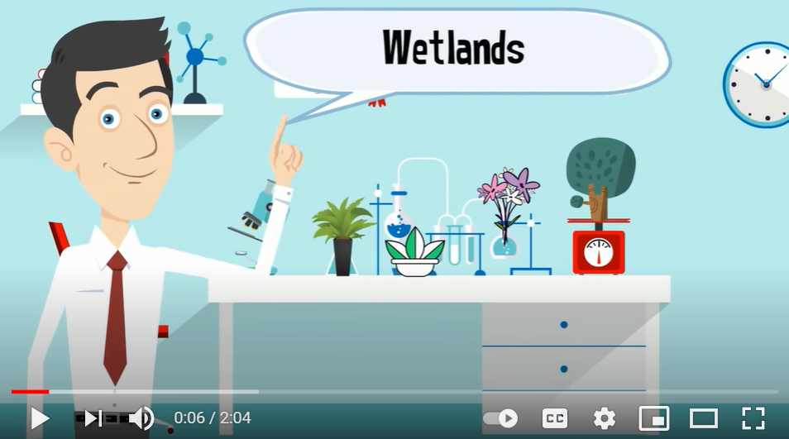
Types of Wetlands
Image and video source: MooMooMath and Science (via YouTube)

Slide 5
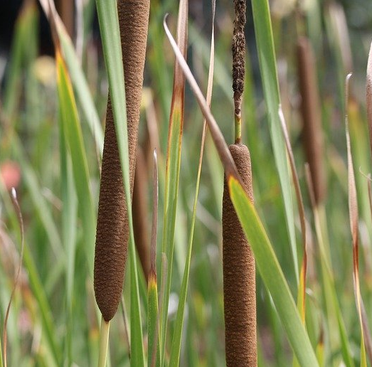
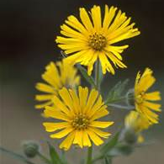
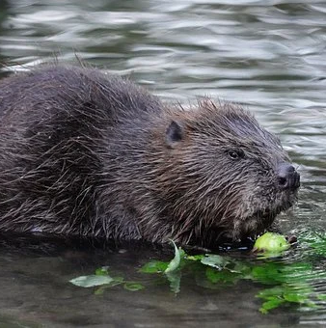
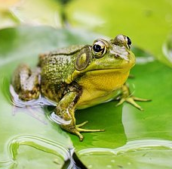
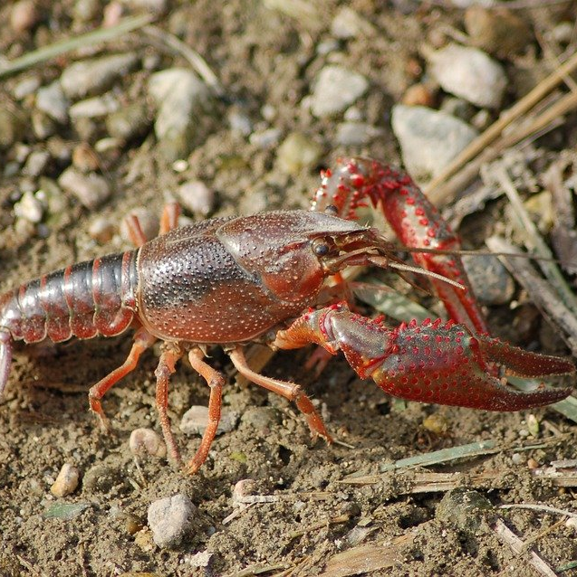
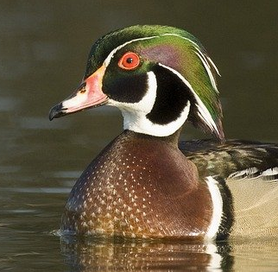
Wetland plants and animals
lep’ées (cattail)
k’ò’x (tarweed)
spíin (beaver)
Lap^{h}áam (frog)
lipíis (crayfish)
Séem (duck)
Images source: Pixabay; Wikimedia Commons

Slide 6
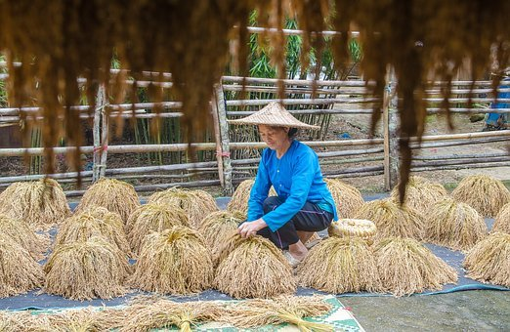
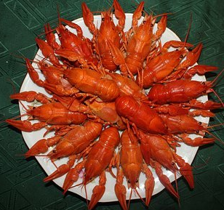
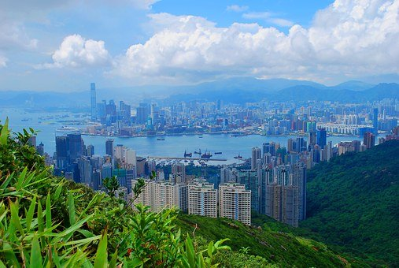
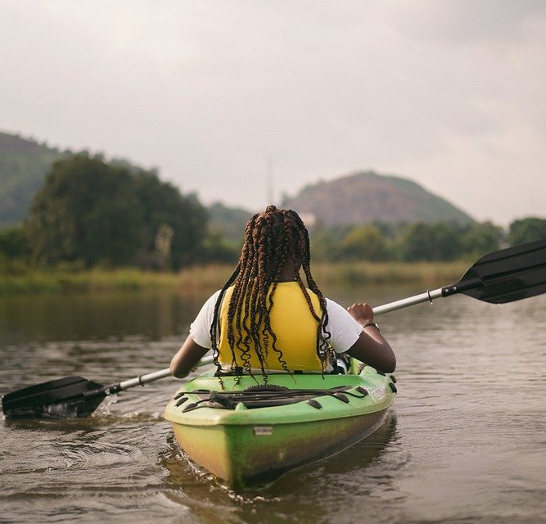
Humans and wetlands
Saltwater and freshwater wetlands have nurtured human lives and societies for millennia. They offer food, useful materials, protection from floods, and recreation.
Images source: Pixabay

Slide 7
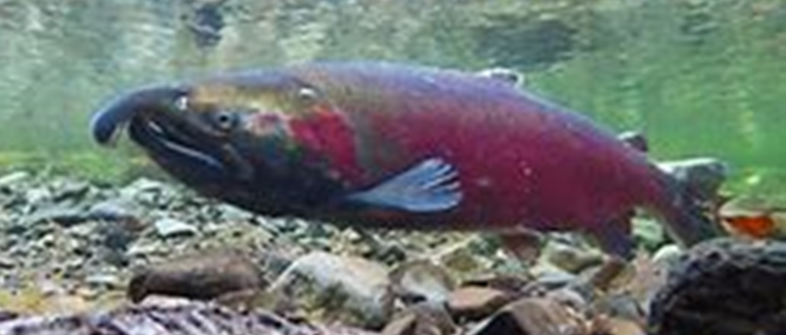
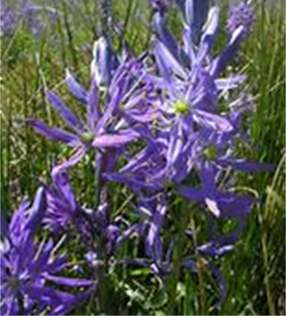
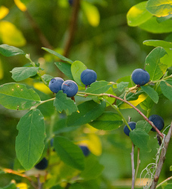
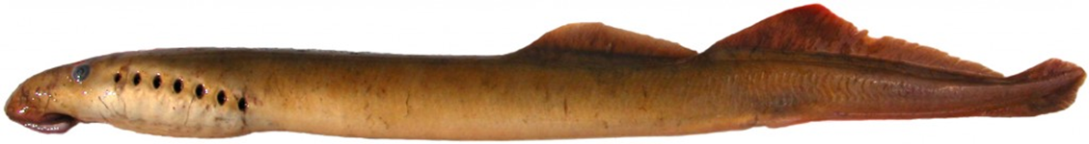
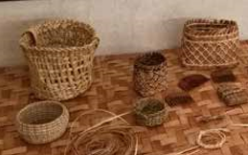
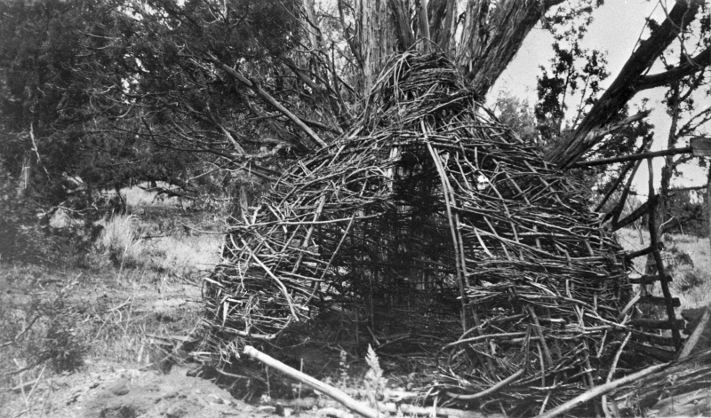
Cow Creek people and wetlands
Cow Creek people have lived in Southwest Oregon for thousands of years. Wetlands provide them with first foods and traditional supplies for clothing, housing, tools, and arts and crafts.
Pʱím (salmon)
Tíip ͪ (camas)
Keléx (huckleberry)
Xtáan (lamprey)
K’olói (basket) materials
Shelter materials
Image sources: Wikimedia Commons; Cow Creek Band of Umpqua Tribe of Indians

Slide 8
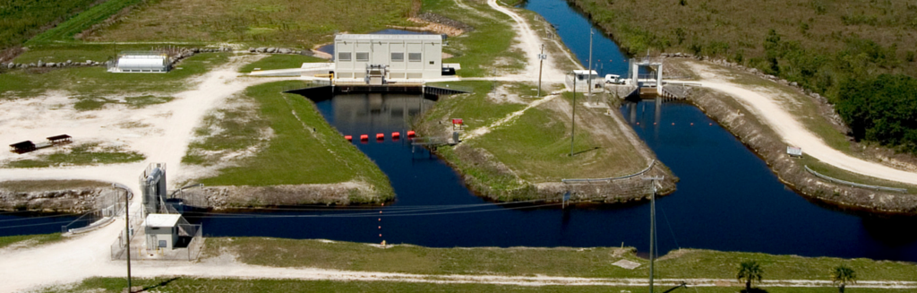
Big changes
New people moved into the Cow Creek homelands and wanted to use wetlands. They attacked the Cow Creek people and forced them off their land. They made big changes to wetlands and used them in ways that are harmful.
Threats to Wetlands
Drainage
Dredging
Stream channelization
Filling
Diking and damming
Tilling for crop production
Levees
Logging
Mining
Construction
Stormwater runoff
Air and water pollutants
Nutrient pollution
Releasing toxic chemicals
Invasive species
Livestock grazing
Fragmentation
Water withdrawals
Vegetation cutting
Recreational over-use
Overharvesting
Climate change
Image source: National Park Service

Slide 9
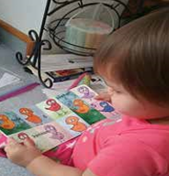
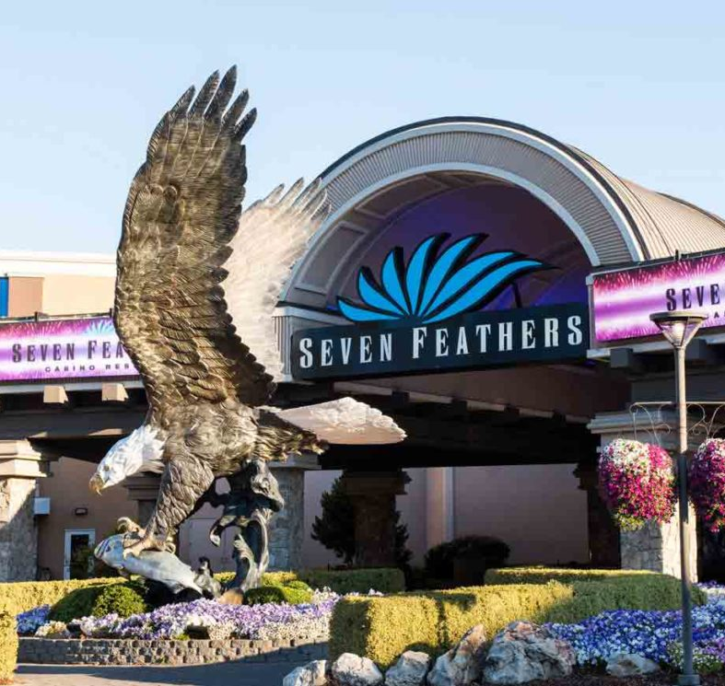
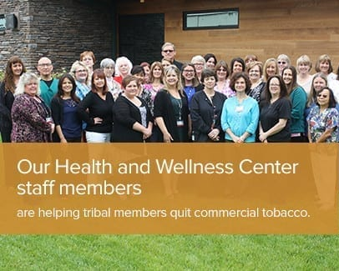
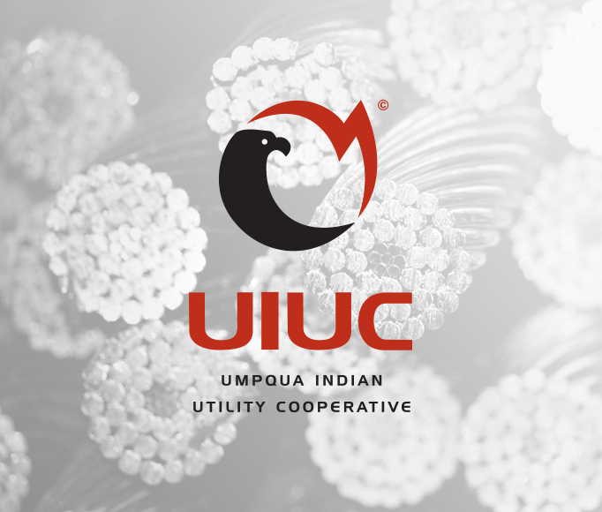
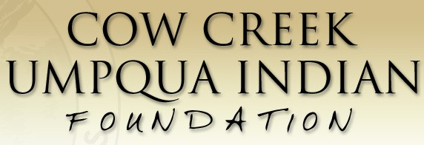
Surviving and thriving
Life was hard for the Cow Creek people for many decades, but they found ways to survive. Today, they work to help each other remember the past, live a good life today, and plan for the future.
Images source: Cow Creek Band of Umpqua Tribe of Indians

Slide 10
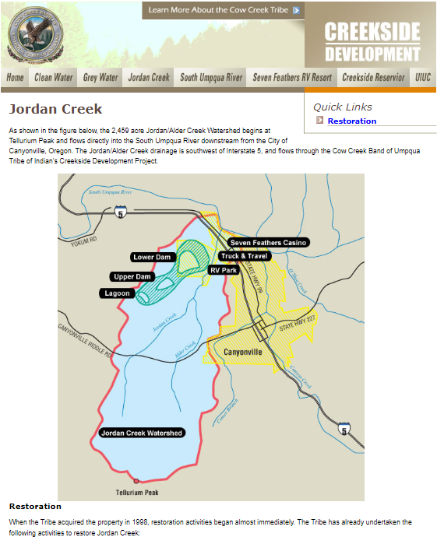
Stewarding resources for the future
The Cow Creek Band of Umpqua Tribe of Indians is working with partners to restore, protect, and sustainably manage water and land resources in Oregon to benefit future generations.
Image source: Cow Creek Band of Umpqua Tribe of Indians

Slide 11
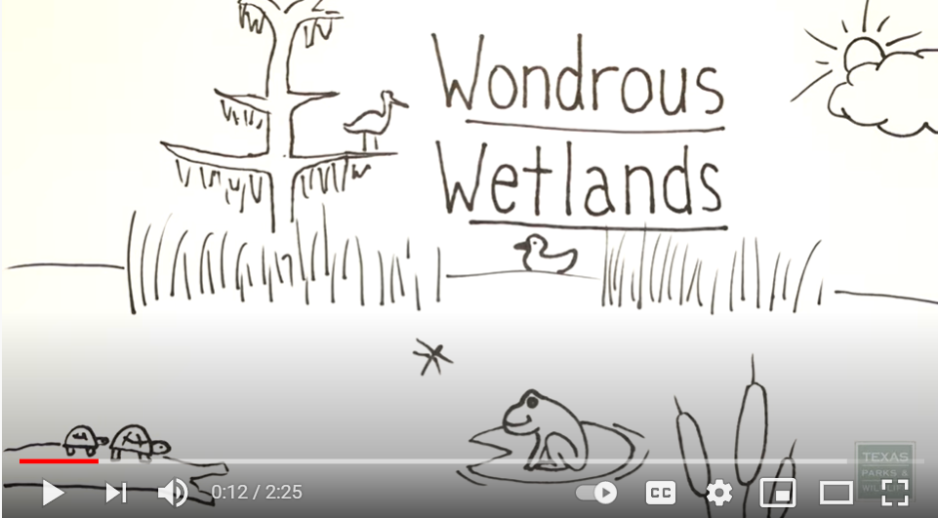
Why wetlands are special places
Image and video source: Texas Parks and Wildlife (via YouTube)

