Slide 1


Beaver Teeth Dice Game
Creating statistical questions and displays while playing a traditional Cow Creek Band of Umpqua Tribe of Indians betting game

Slide 2
Statistical Questions
Questions we answer by collecting data AND when there might be some variability in the data.
Example
On average, how old are the dogs that live with our classmates?
Non-Example
Do you like dogs?
Notes:
Explain that in the first example, there is variety, some dogs may be young, some classmates may have no dogs or multiple dogs. We would also need to go about collecting data to find out the answer.
In the second question, there is no variability. The question is a single response for a single person. No need to collect data that varies

Slide 3
Why are these statistical or not statistical questions?
Examples | Non-Examples
On average, how old do beavers in the Umpqua River live to be? | How old is Maple the beaver that lives at the Oregon Zoo?
How many sixth-graders have observed beavers in real life? | How many days are in January?
How many logs do beavers use to create a dam? | Have you ever played Beaver Teeth Dice game?
Notes:
Student groups to present why/ why not
Maple the beaver https://www.idahostatesman.com/news/nation-world/national/article250322126.html#:~:text=Maple%20the%20beaver%20went%20into,was%20collecting%20one%20for%20herself.

Slide 4
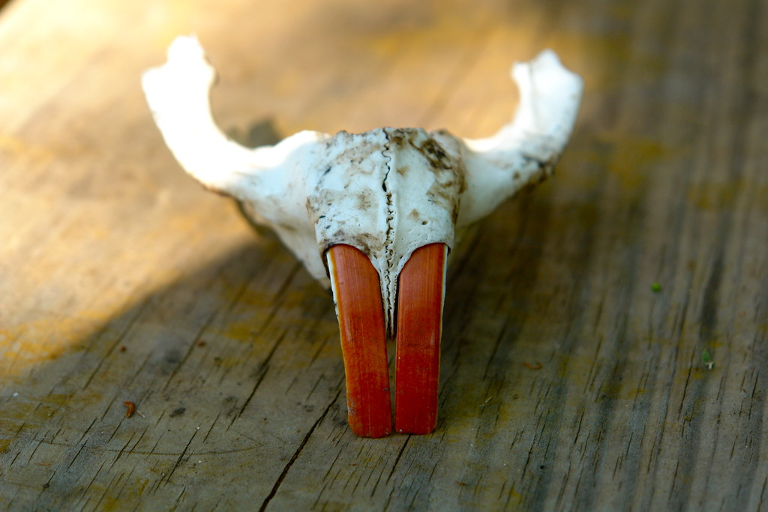
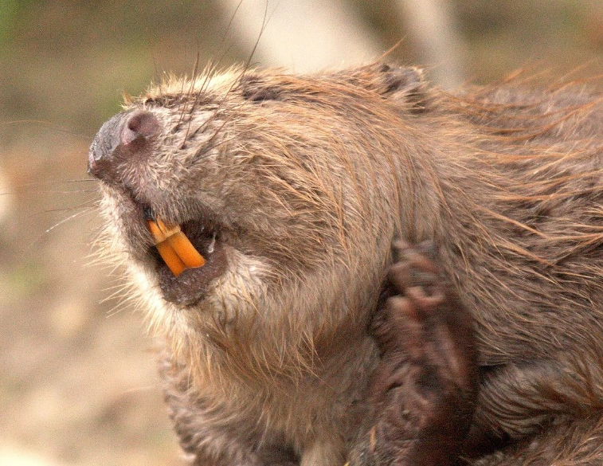
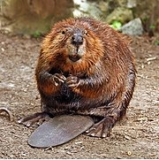
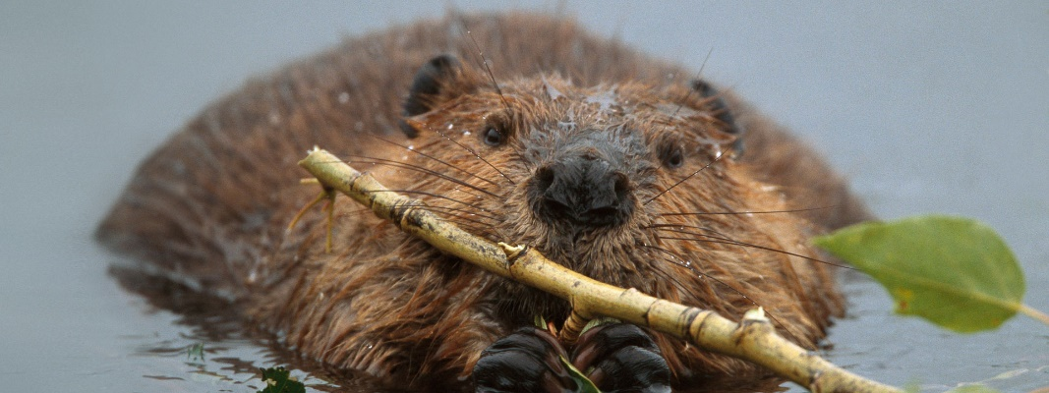
Mathematicians ask questions
Notes:
Looking at these pictures, what are some questions you can create?
Students can read https://oregonwild.org/wildlife/beaver to also gather additional information.

Slide 5
Cow Creek Band of Umpqua Tribe of Indians
Lived between the Cascade Mountains and Coast Range in Southwestern Oregon, along the South Umpqua River and its primary feeder stream, Cow Creek.
Territory included the entire Umpqua watershed; however, the Tribe was very mobile.
One of nine federally recognized Indian Tribal Governments in Oregon.
The Cow Creek Tribal Nation, located in Southwestern Oregon, is governed by an elected 11-member council known as the Tribal Board of Directors.
Information from: https://www.cowcreek-nsn.gov/tribal-story/

Slide 6
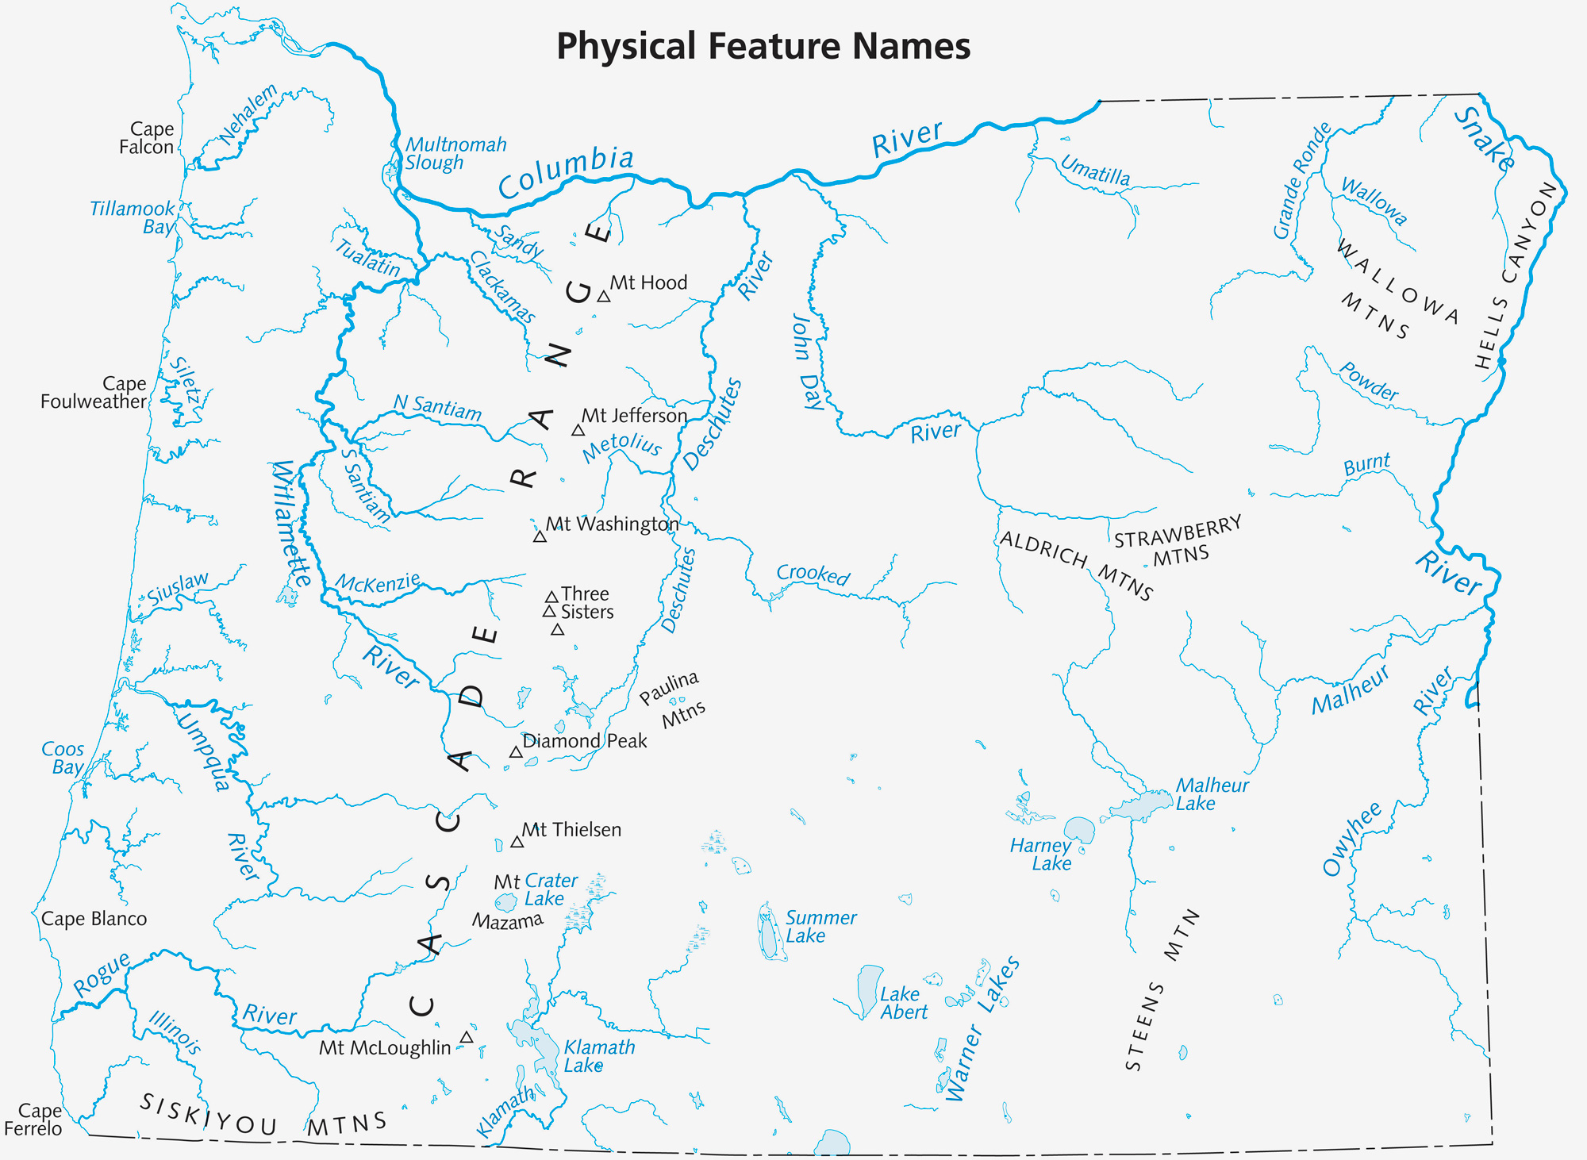
Image from: https://sos.oregon.gov/blue-book/PublishingImages/facts/almanac/map-physical.jpg
Notes:
lived between the Cascade and Coast Ranges in Southwestern Oregon, along the South Umpqua River and its primary feeder stream, Cow Creek.
territory included the entire Umpqua watershed; however, the Tribe was very mobile. A vast area surrounding this watershed was known as their trade, hunting and gathering area. This area extended north into the Willamette Valley and to the east to Crater Lake and the Klamath Marsh area, as well as reaching as far west as the Coast Range and south through the Rogue River Watershed into the Siskiyous.

Slide 7
Resources
The area was rich with resources including plants and animals.
The landscape provided shelter, and there were many places that held great importance for the Tribe.
Members were diligent about using all the resources well, including grasses for baskets, animal hides for quivers to carry arrows, and teeth and bones for tools and games.

Slide 8
Hard work and play
Living on and taking care of the land was important and so was socializing.
Several tribes would be in contact with the Cow Creek band to trade, play games, socialize, and build relationships.
Many games were betting games that gave players the opportunity to show their skills and to win items of value.
Games and materials were often shared across the multiple Tribes from all across the region.

Slide 9
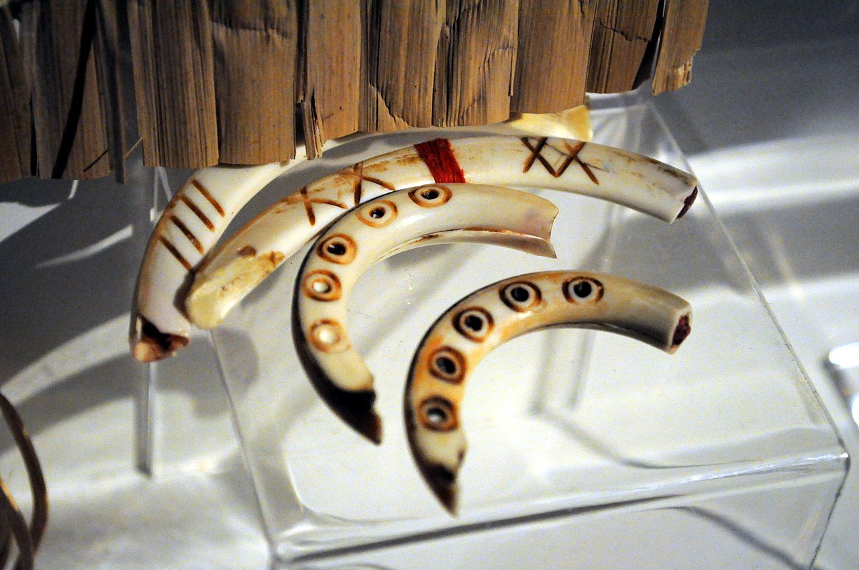
This Photo by Unknown Author is licensed under CC BY-SA
Notes:
To play the game, you may purchase Beaver teeth from a variety of purveyors and decorate. You may also use sticks or other pieces of readily available materials for the classroom sets. One set has circles, the other has cross hatches, x’s or lines. One circle design is more elaborate than the other. One hatch design is more elaborate than the other.
Extension May purchase the picture book Beaver Tooth: An Authentic Game from the First People of the Pacific Northwest by David G. Gordon & Mike Kowalski, but it is out of print and copies are limited.

Slide 10
Beaver Teeth Dice game
Beavers were abundant and their teeth were strong enough to allow for intricate designs and light enough to be carried easily.
Rules of play could vary, but the basic rules were fairly common among Tribes in the Pacific Northwest.
Language differences were okay since there was no need to talk when playing.

Slide 11
To play the game
“We would use sticks that were painted as counting sticks. And the dice would either be beaver teeth or bone. Either one had unique markings.”
Each team needs
2 pairs of teeth
2 with circle designs (one is more elaborate)
2 with arrows, cross-hatching or lines (one is more elaborate)
24 counting bones
Two teams face each other. The first player holds the teeth with two hands and shakes it, then tosses it to the ground. The teeth are counted and points are awarded. Keep count of points using the bones.

Slide 12
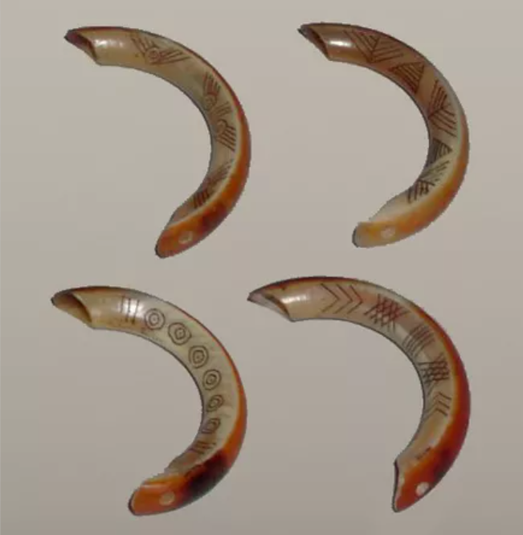
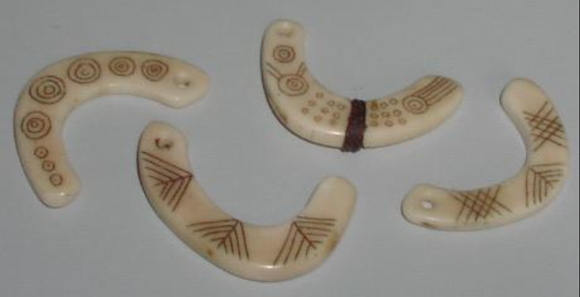
Teeth with the arrow or other markings are called “male”.
Teeth with circle designs are called “female”.

Slide 13
Points
After you throw, count the points and collect the counting bones for each point. If you score an uneven number, your turn is over and it is passed to the other team or player.
Teeth combination | Points awarded
Both males up | 1
Both females up | 1
All dice up | 4
Any other combination | 0

Slide 14
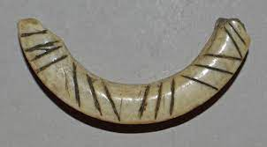
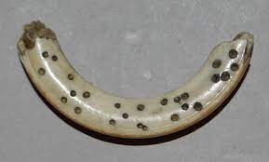
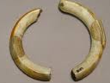
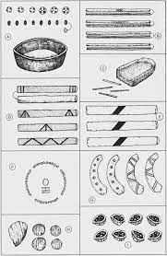
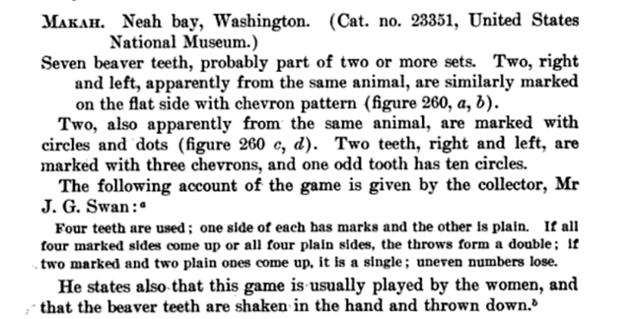
There may be slight differences in how to play
Examples of carved beaver teeth collected and housed in the British Museum

Slide 15

Dot plot
Frequency Table
Way to track data points on a simple scale, with dots to represent number of occurrences
Organizes data in three columns that list the items and show the number of times the item occurs

Slide 16
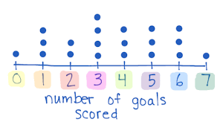
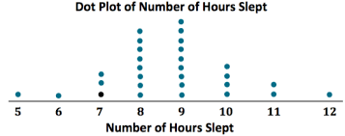
Dot plot examples

Slide 17
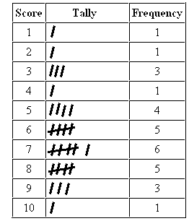
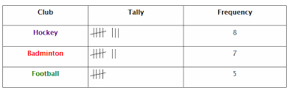
Frequency table examples

Slide 18
How will your team gather and display your data?
2 male
2 female
2 male
1 female
1 male
2 female
2 female
2 male
1 female
1 male
All blank

Slide 19
How will your team gather and display your data?
Dice | Tally | Frequency
2 female, 2 male | | | 1
2 female, 1 male | |||| | 4
2 female | | | 1
2 male, 1 female | || | 2
2 male |  | 0
1 female | |||| | | 6
1 male | ||| | 3
blank | | | 1

