Slide 1


The Cow Creek Band of Umpqua

Slide 2
Definitions
Tribe: A group of native people that share similar cultural, social, political and/or economic characteristics.
Band: A group of native people joined in a common purpose or connection; a smaller part of a tribe.

Slide 3
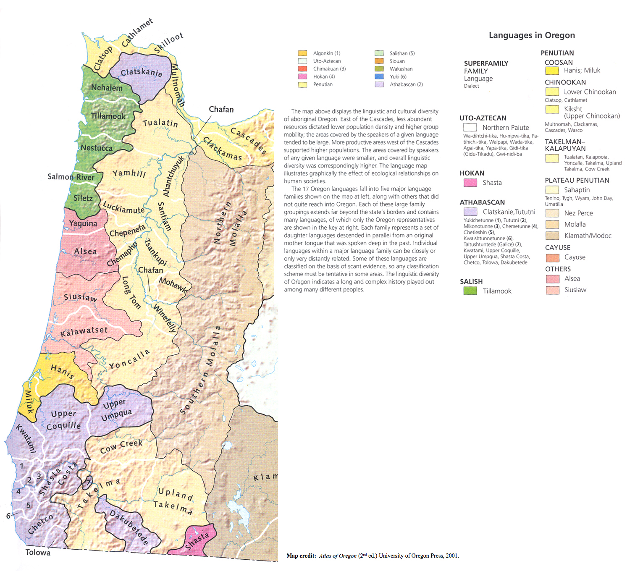
Languages of Native Western Oregon

Slide 4
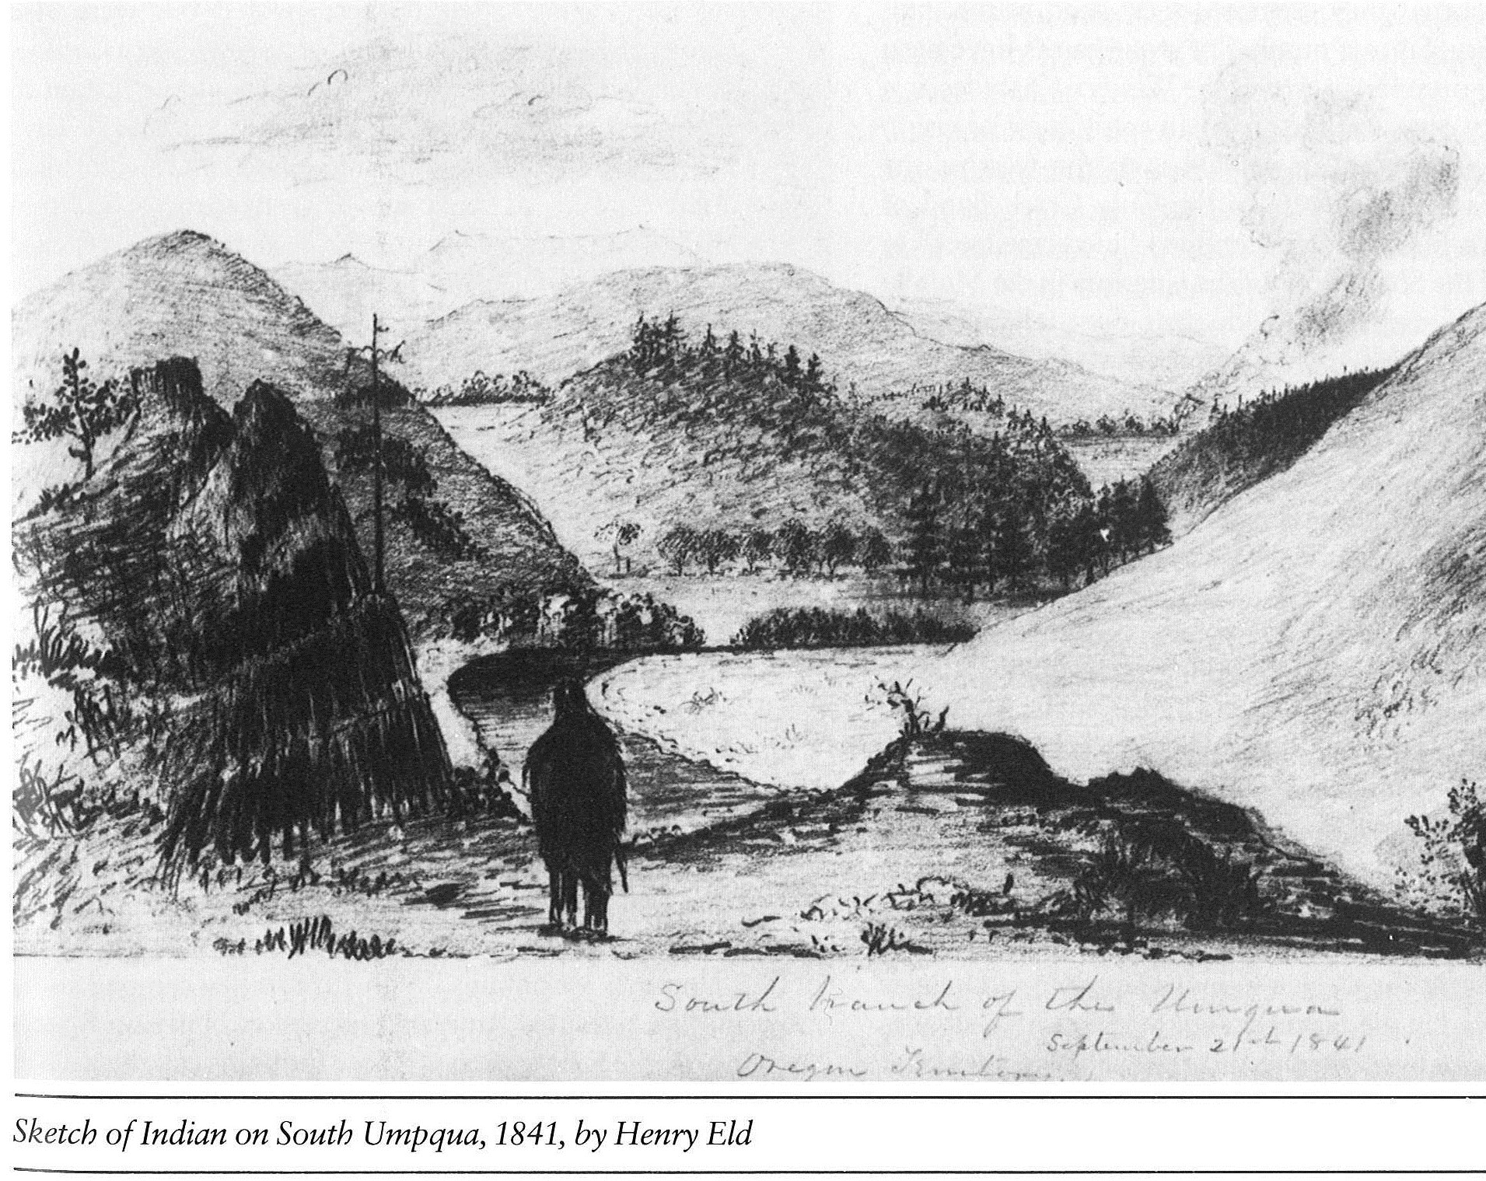
Cow Creek Bands
Miwaleta
Quintiosa
Targunsan
Wartahoo
Myrtle Creek

Slide 5
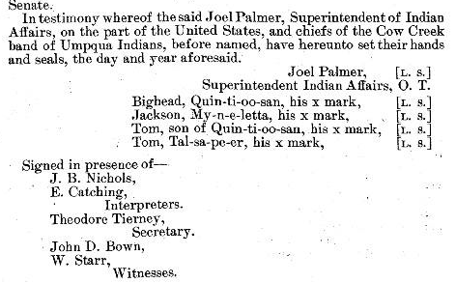
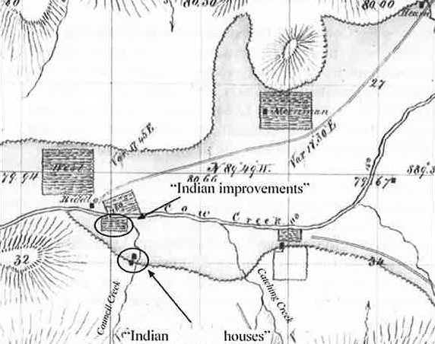
Treaty with the Umpqua –
Cow Creek Band September 19, 1853

