Slide 1


Revitalization

Slide 2
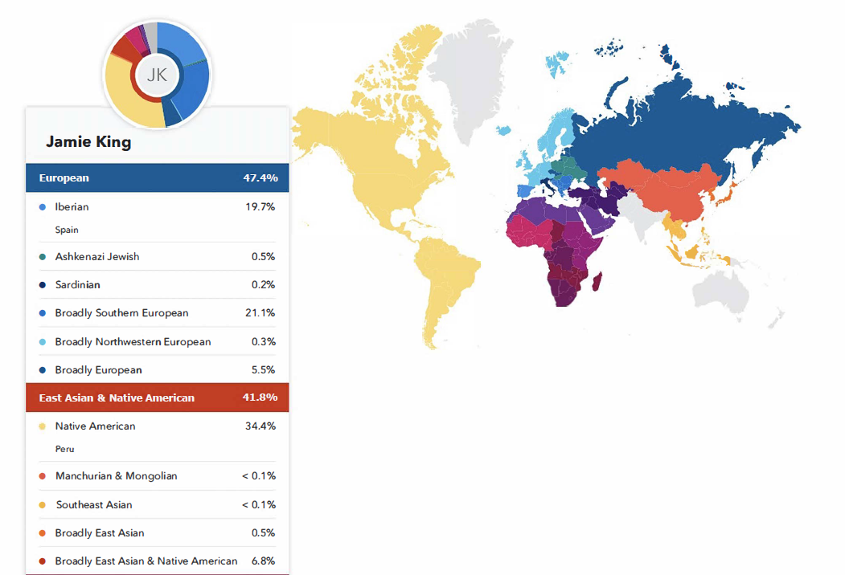
Sample
Notes:
This is not a real person. It is a sample provided by the company 23 and Me.

Slide 3
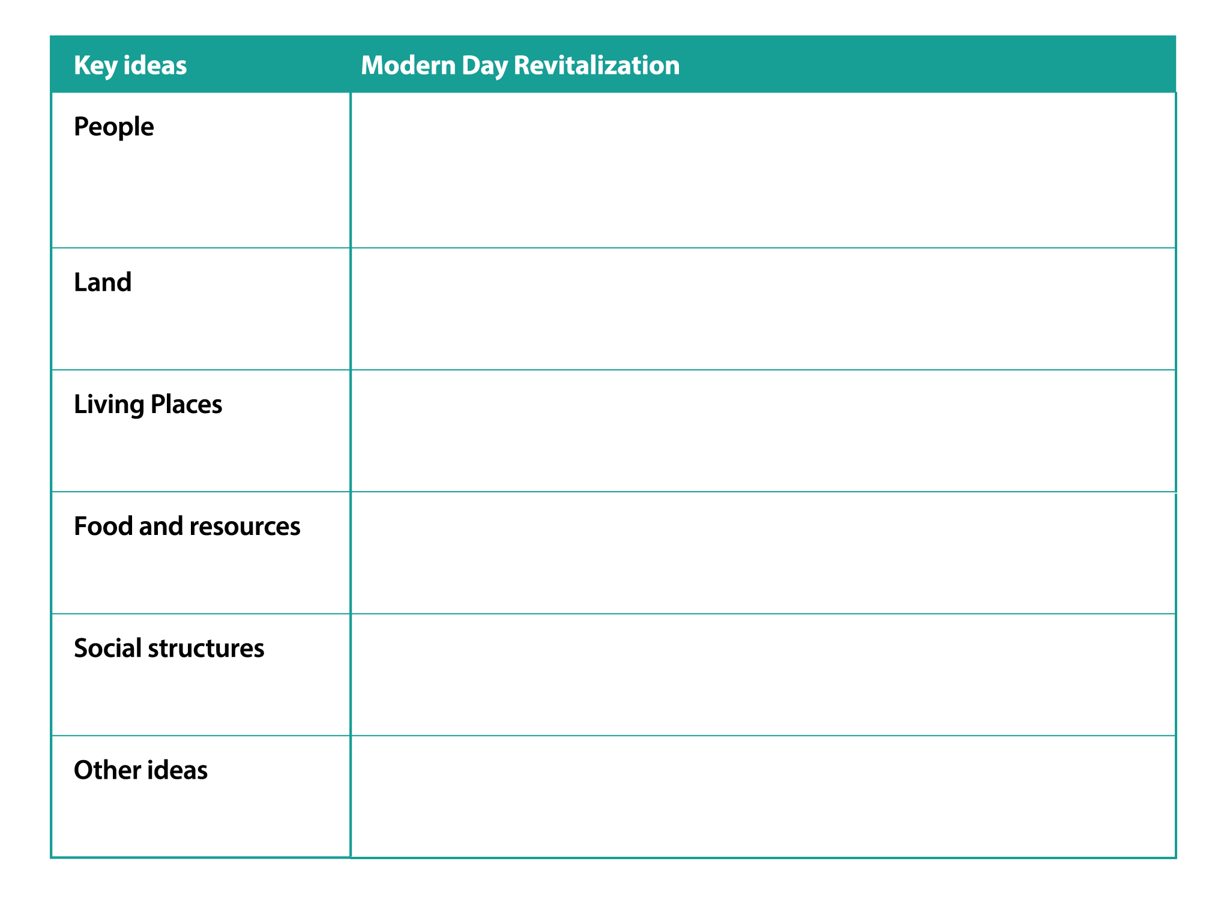
Cow Creek Umpqua Tribe
Modern Day Revitalization
Directions: In the last lesson, you learned about the current history of events that led up to the modern era for the Cow Creek Tribe. Today, we are learning about what the tribe is doing to revitalize its people and way of life. Do a gallery walk and review the posters that are provided. Take notes that answer the following question for each category. What is the tribe doing to connect the modern _______ (people, land, living place, etc.) to its historical way of life?
Notes:
This is not a real person. It is a sample provided by the company 23 and Me.

Slide 4
Cow Creek Tribe Revitalization Efforts
How is the tribe revitalizing its people?
How is the tribe revitalizing the land?
How is the tribe revitalizing the ways in which its members live or the places they live?
How is the tribe revitalizing its members’ knowledge of food and resources?
How is the tribe revitalizing or strengthening its social structures, either
with its members or through its interactions with surrounding communities?
What other ideas stand about what the tribe is doing to revitalize its traditions, rituals, and ways of life?
Notes:
This is not a real person. It is a sample provided by the company 23 and Me.

