Slide 1
Takelma Language

Slide 2
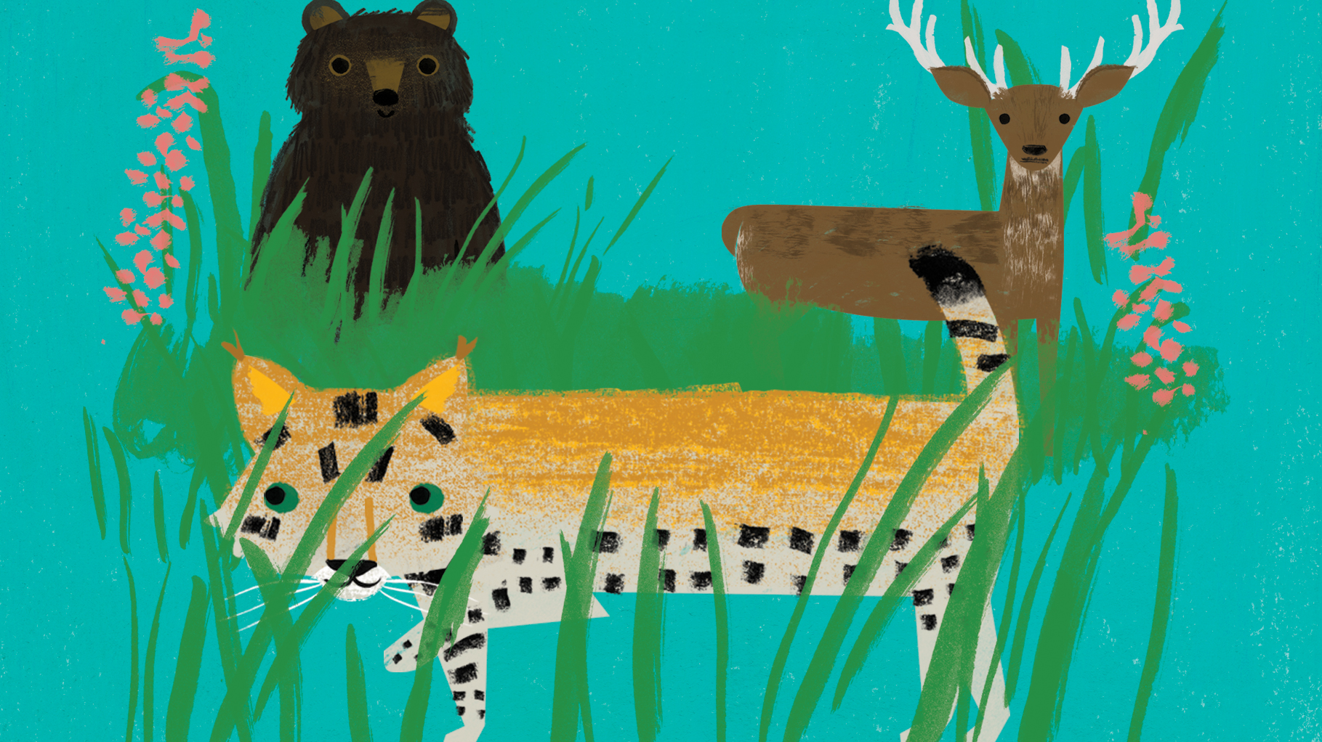
Animals

Slide 4
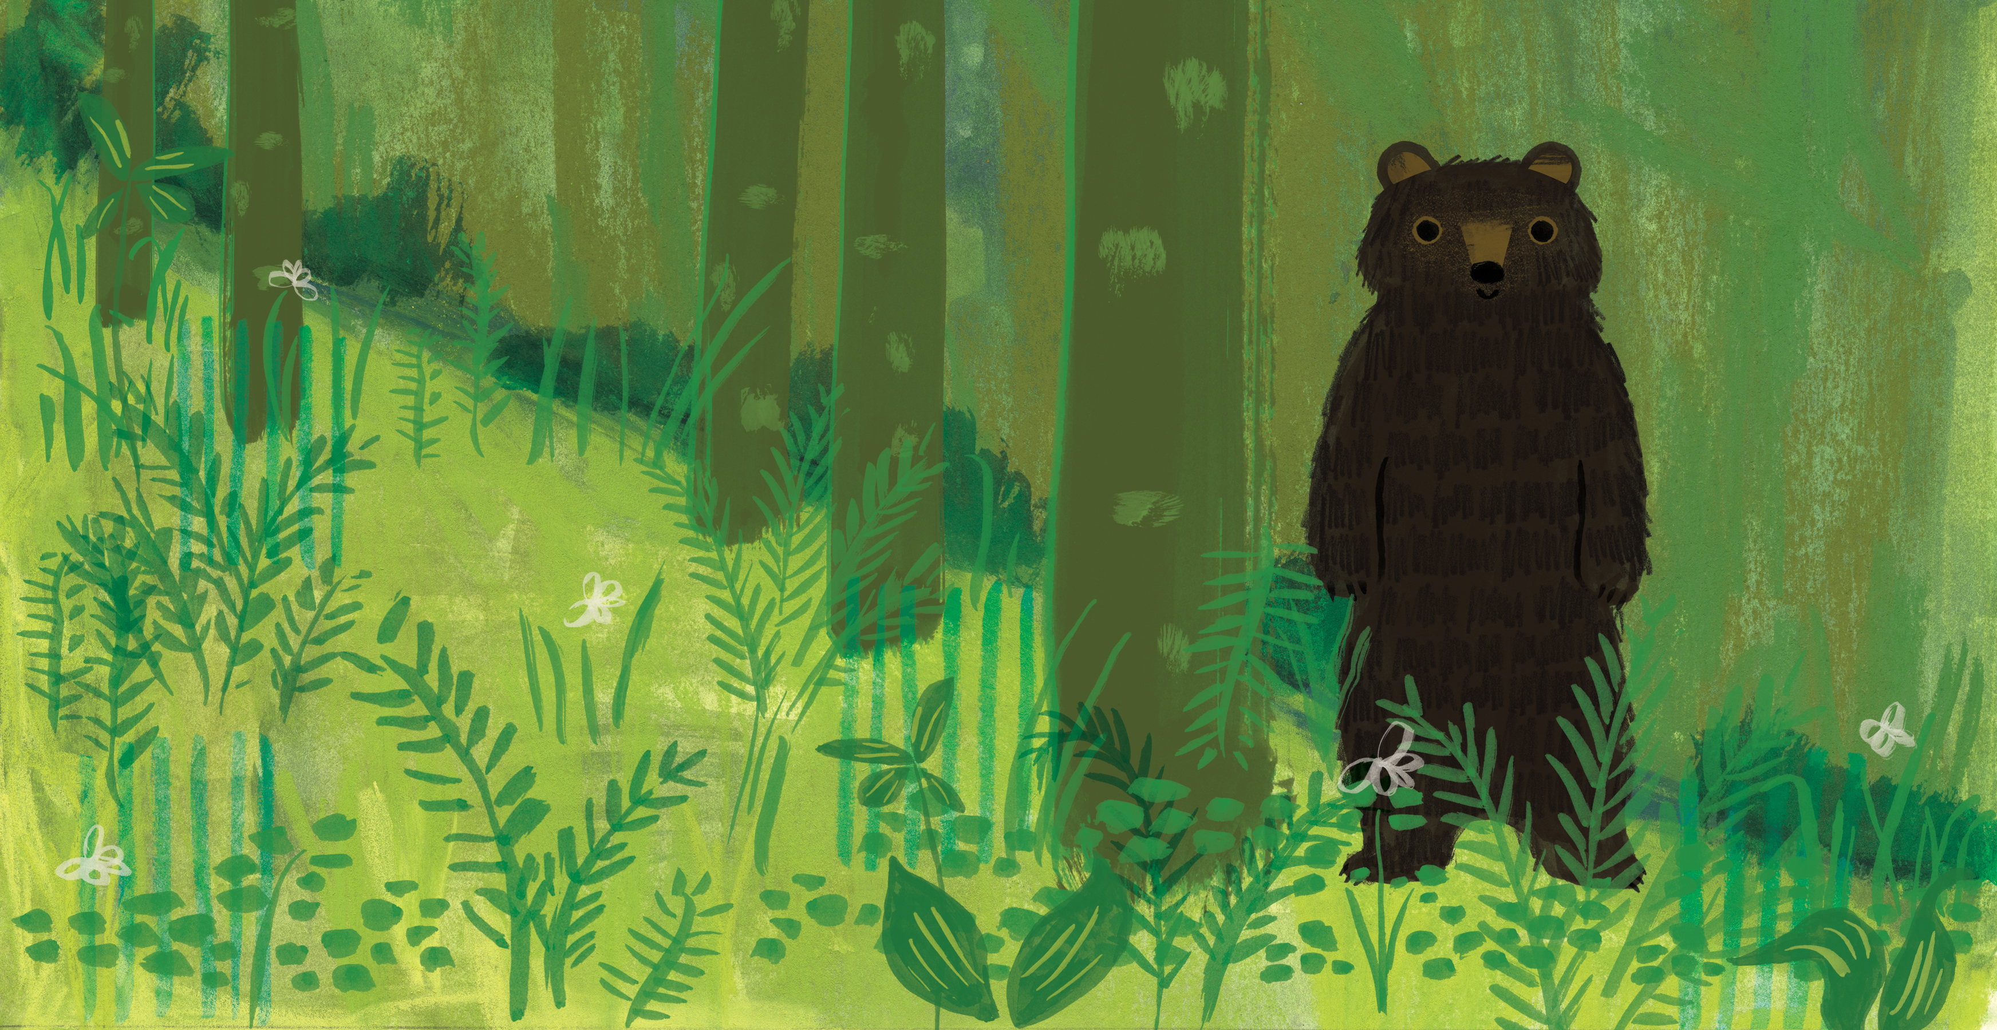

Slide 10
Places

Slide 12
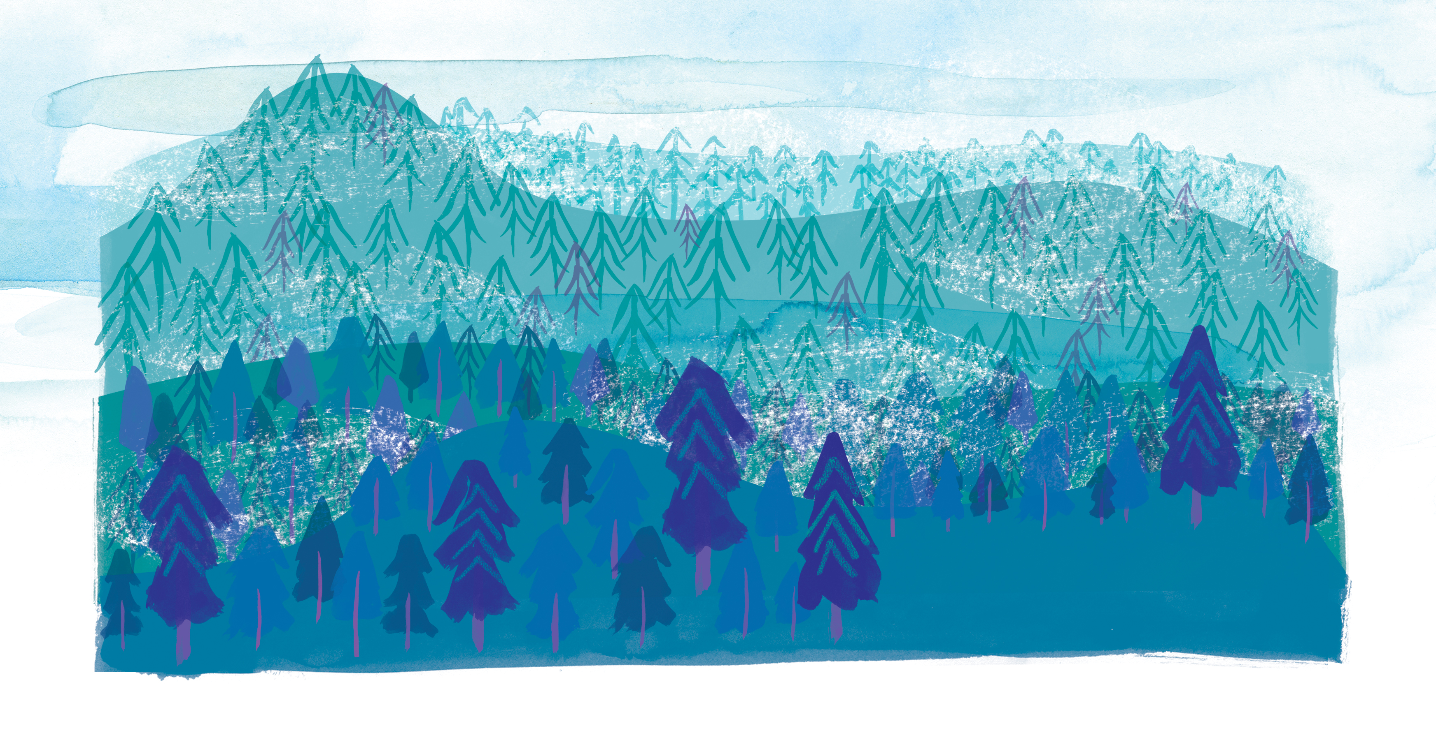

Slide 17
